Slide 1
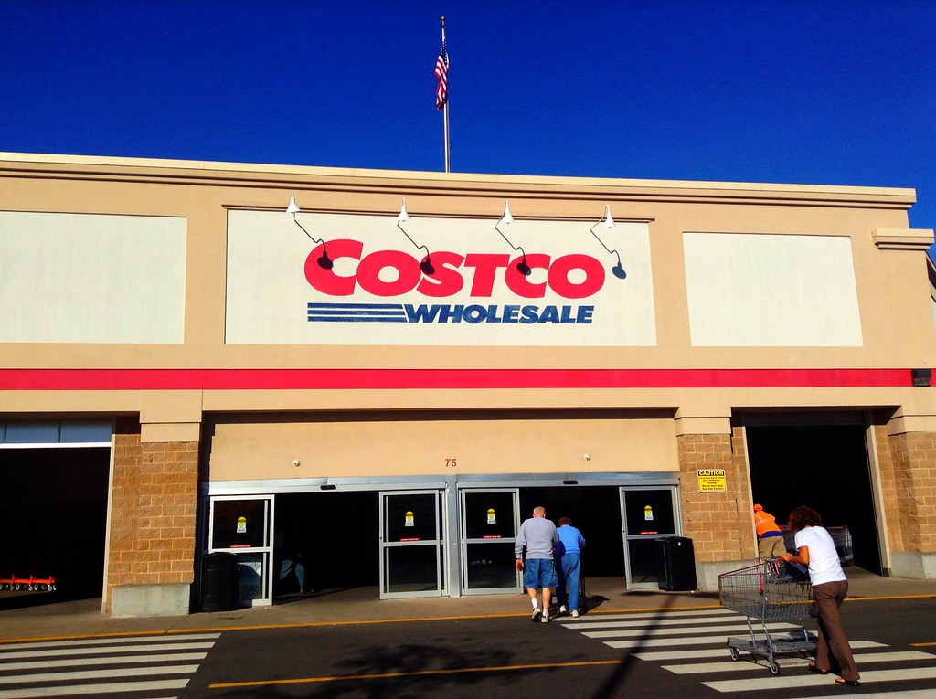
Suh-perior Returns
ThePhoto by PhotoAuthor is licensed under CCYYSA.

Slide 2
Table of Content
Financial ratios for profitability, leverage, efficiency, liquidity & market value
Common size & percentage change analysis
Summary of Costco's results
Costco's current strategies, weaknesses and strengths
Challenges and recommendations
Beating Costco as a competitor
References

Slide 3
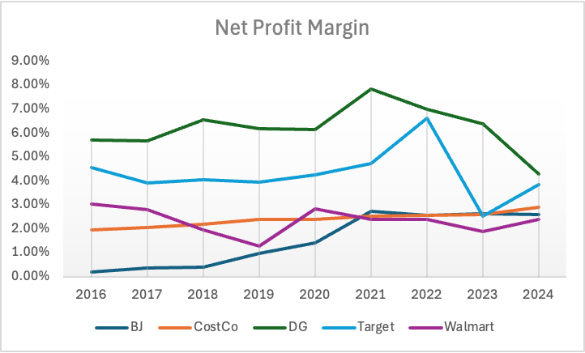
Net Profit Margin

Slide 4
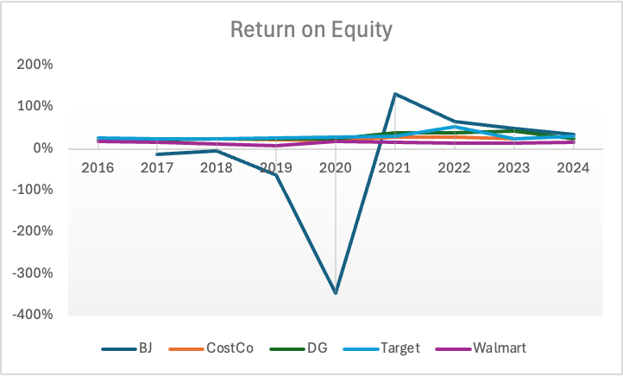
Return on Equity

Slide 5
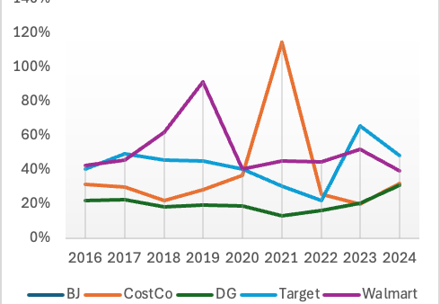
Dividend Payout Ratio

Slide 6
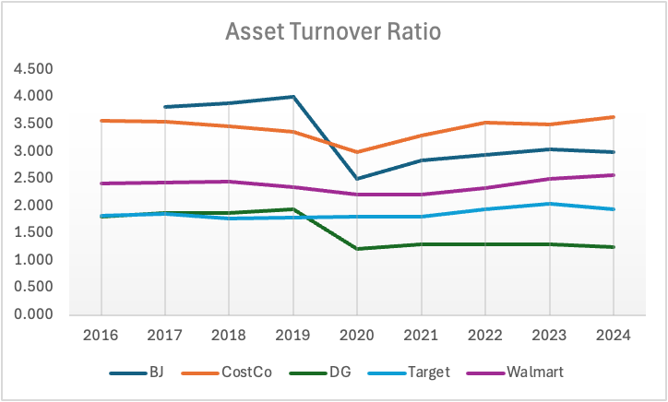
Asset Turnover Ratio

Slide 7
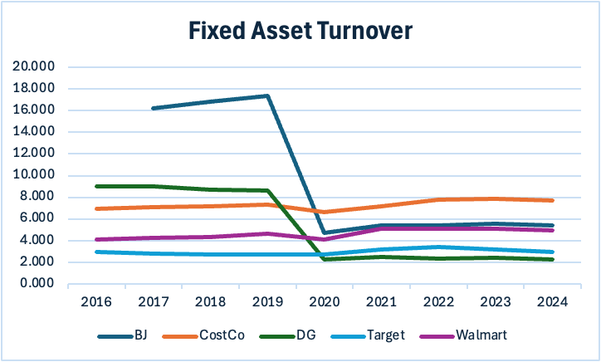
Fixed Asset Turnover
Notes:
Fixed asset turnover is a financial efficiency ratio that shows how well a company uses its fixed assets
Higher ratio → the company is using its fixed assets efficiently

Slide 8
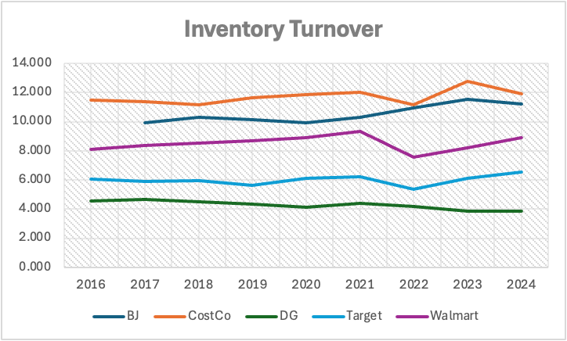
Inventory Turnover
Notes:
how many times a company sells and replaces its inventory during a period.
Higher turnover → inventory sells quickly

Slide 9
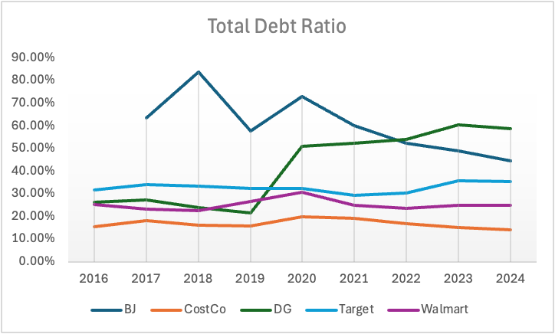
Total Debt Ratio
Notes:
how much of a company’s assets are financed by debt.
Lower ratio → more equity financing, lower risk

Slide 10
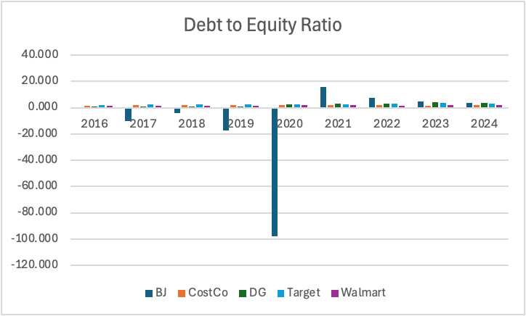
Debt to Equity Ratio
Notes:
how much debt a company uses relative to shareholders’ equity.
negative debt-to-equity ratio means negative equity (liabilities exceed assets)

Slide 11
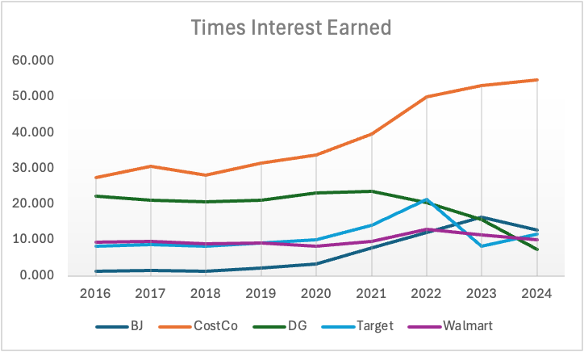
Times Interest Earned

Slide 12
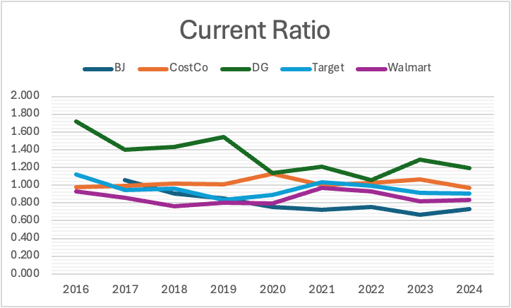
Current Ratio

Slide 13
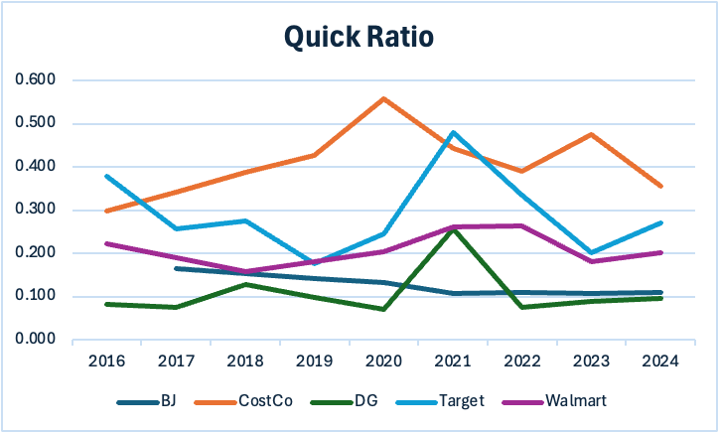
Quick Ratio

Slide 14
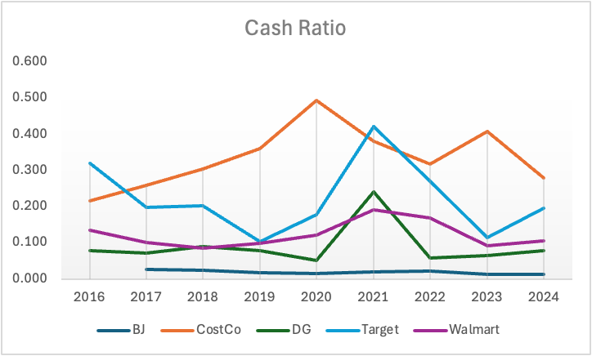
Cash Ratio

Slide 15
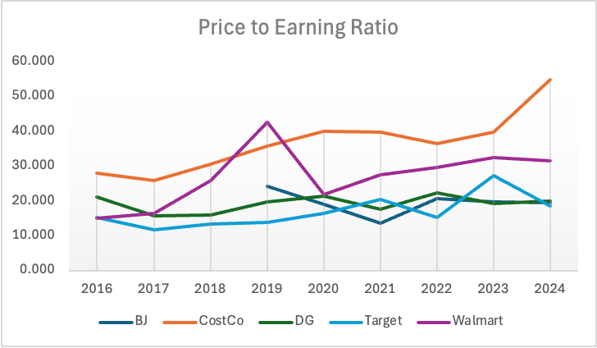
Price to Earning Ratio

Slide 16
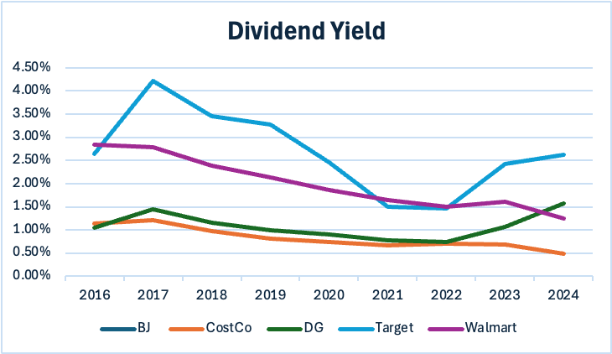
Dividend Yield

Slide 17
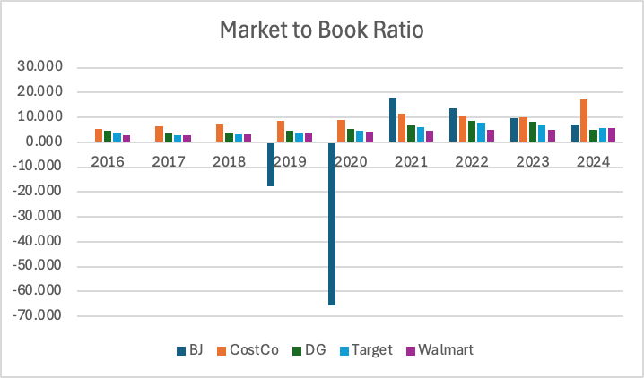
Market to Book Ratio

Slide 18
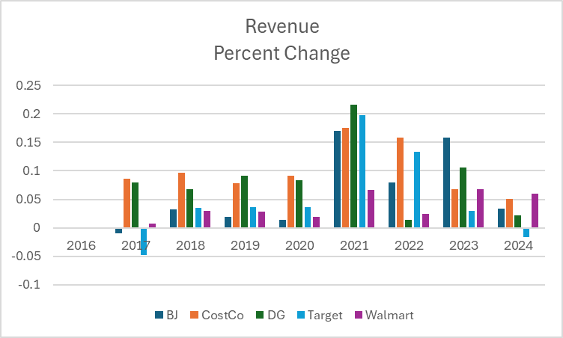
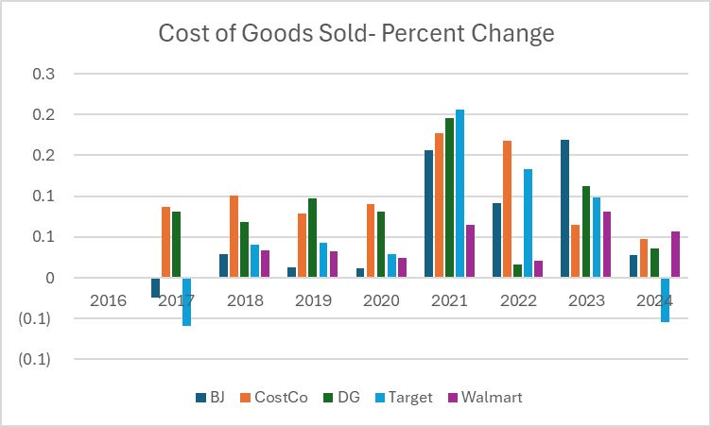

Slide 19
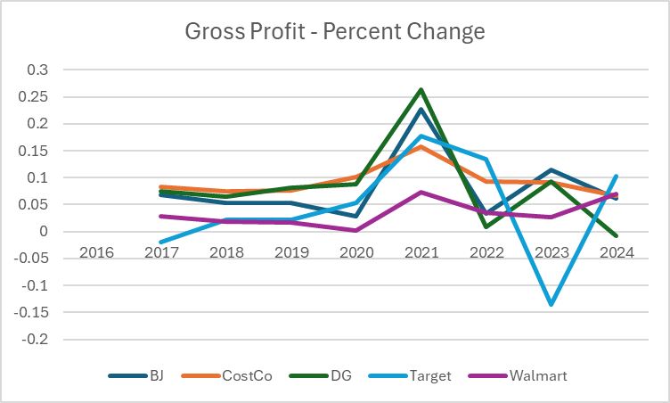
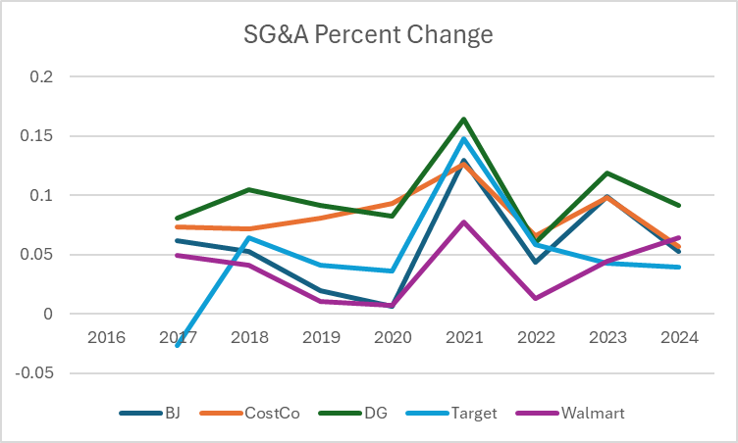

Slide 20
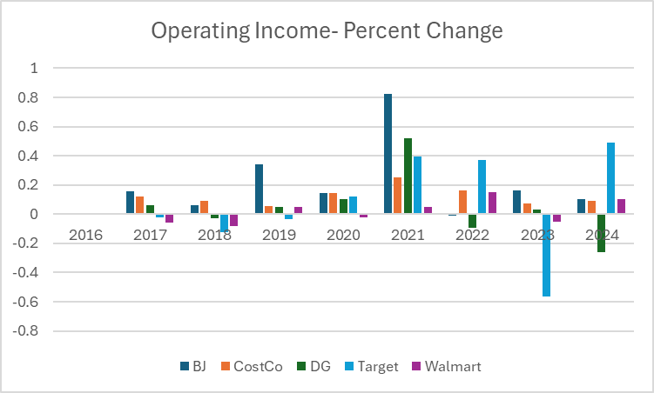
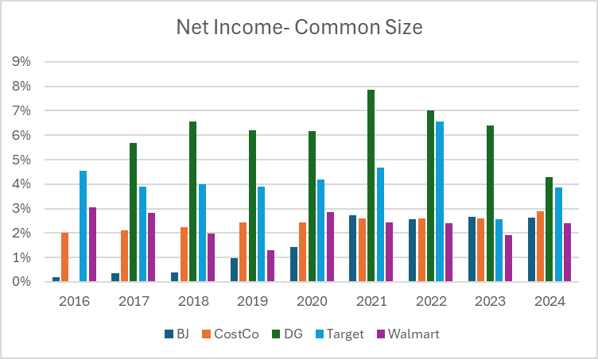

Slide 21
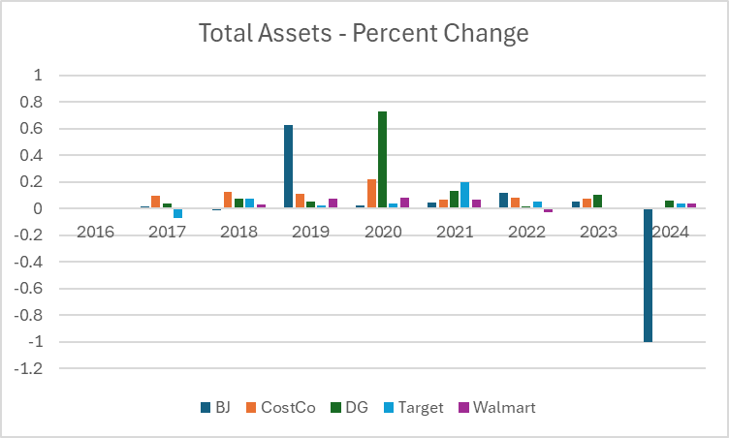
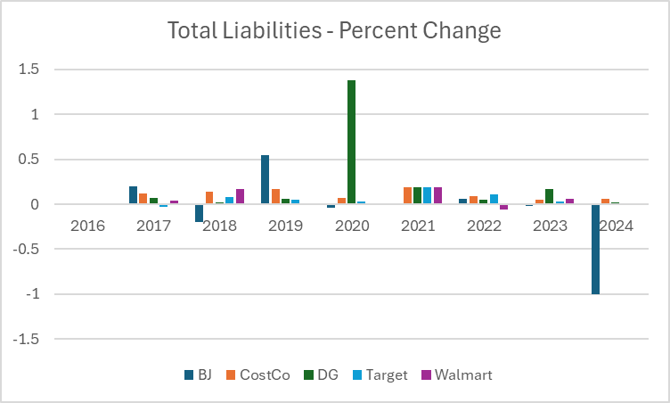

Slide 22
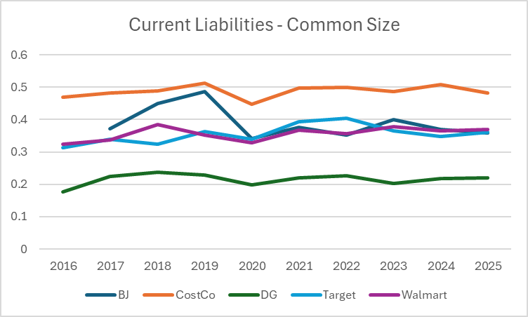
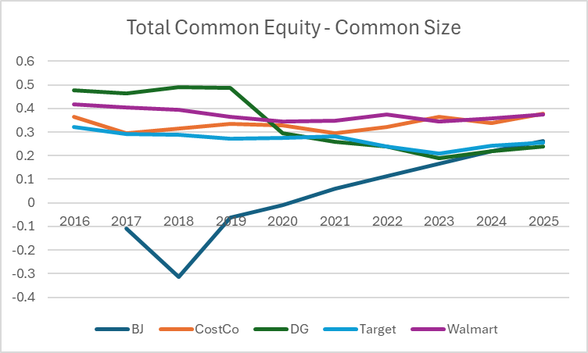

Slide 23
Comparison
Compared to competitors Costco has been able to keep their liabilities low.
Not only are they low but they are not as volatile as the competition.
They are a consistent company with year over year profit growth staying consistent even during the pandemic.
Costco has been able to continue the Membership Warehouse model while the competition has not been able to. Even Walmart's main store isn't under this model.

Slide 24
Costco's Current Strategies
Scale Driven Low Price Strategy
  Costco has reported over a 135 million dollar jump in the revenue section of their balance sheet.
  It is clear that Costco's strategy to focus on revenue growth and volume helps them excel in their industry increases their revenues year to year.
  Costco aims to make their profits on the high volume of bulk sales they receive, as well as the money they receive from memberships. Their focus is NOT on product margins.
  Memberships are so appealing to customers because of the lower prices of products Costco offers, which drives membership retention and more overall volume
Membership Based Profitability
  Costco utilizes the strategy of keeping super thin merchandise margins keeping profits small on products but making the bulk through membership fees.
  Doing this ensures a stable operating income from products and other items and revenue growth from membership's
  Costco is now able to have the ability to consistently fund their expansion of stores in different locations
  Keeping thin margins allows customers that are fully focused on products margins to be more inclined to pay membership fees to ensure that they get those margins, which Costco has.
  This strategy helps Costco predict long term planning, as they can use the growth of memberships to help expand to new locations
  Keeping the margins thin gains the trust of members, allowing Costco to have full power over membership fees and when to increases them.

Slide 25
Costco's Current Strategies (continued)
Cost Discipline
  Costco intentionally sells less products than traditional retailers. They do this to get more bulk orders from customers which leads to lower supplier pricing, low distribution costs due to the simpler logistics, and faster inventory movement due to lower storage amounts.
  Costco is also known for their high inventory turnover ratio which is beneficial for inventory costs, as they have less inventory sitting in warehouses. With a fast inventory turnover ratio, also comes the advantage of low spoilage rates of food products. This faster conversion of inventory helps them reinvest cash faster.
  They utilize a warehouse format for their stores which is designed for efficiency rather than customer experience. Products stay on pallets to lower shelving labor, allows for faster restocking, and lower maintenance costs.
Private label
  Having a private label gives Costco an edge over national brands. These private labels cost much less ton produce and distribute out to stores because they are able to avoid packing, marketing, and brand licensing expenses. In addition, the source of the brand is directly from the manufacturer, it makes it far cheaper than other retailers.
  Having the "Kirkland" brand allows Costco to change prices quicker than others since it doesn't depend on national pricing structures. They can increase and decrease prices quickly, as needed.
  Customers find the "Kirkland" brand as a high-quality brand often at a lower price than nationally used brands. It helps costumer's from switching to competitor's and also gains loyalty between Costco and customers.

Slide 26
Costco's Struggles
Heavy Dependence on Consumer Spending Strength
  Costco depends on large, bulk buying behavior to be profitable outside of memberships. When we are in a recession, consumers tend to buy small quantities of products, which could resort to consumers choosing other retailers that aren't as bulk-oriented. The bulk-oriented strategy also limits impulse purchases, since a consumer would have to buy a product in bulk, even if they wanted to just try it.
Low Product Variation
  They sell a lot fewer items than competitors. A lot of times Costco leaves customer's needed to shop somewhere else to fulfill their ship which could lead to losing members to other retailers
  Stores like Walmart or Target beat Costco in product variety because their businesses are more built on offering more SKU's and allows customers to complete shopping trips in one store, unlike Costco, at times.
International Expansion Risk
  Opening a new warehouse internally would require a long-term lease, construction, distribution network setup, and creating relationships with local suppliers in order to be successful. If a location underperforms, Costco will be unable to shrink their costs quickly because most of their expenses are fixed

Slide 27
Challenges in the retail industry
Consumer price & inflation sensitivity
With the way living prices are rising and, also the raise of inflation, consumers have become very particular in spending their money at stores where they have some sort of reward system.
Increase in competition in membership and discounts offered
In the past their biggest competitor was Walmart (Sam's Club), however, competitors such as Amazon, Target and international chains such as Aldi, have started going the extra mile to not only retain their current consumers, but to also attract new consumers
(Financial Contest, 2025)

Slide 28
Challenges in the retail industry (continued)
The demand for convenience and the implementation for e-commerce
Placing and order online and having your items delivered at your doorstep is becoming a convenient preference for most consumers, however, Costco seems to behind with this rapid change in retail compared to its customers (AInvest, 2025)
Diversifying their supply networks will allow Costco, to meet the demand of their customers on time; they should maintain strong relationships with their suppliers through scale purchasing.
Global sourcing risks and supply

Slide 29
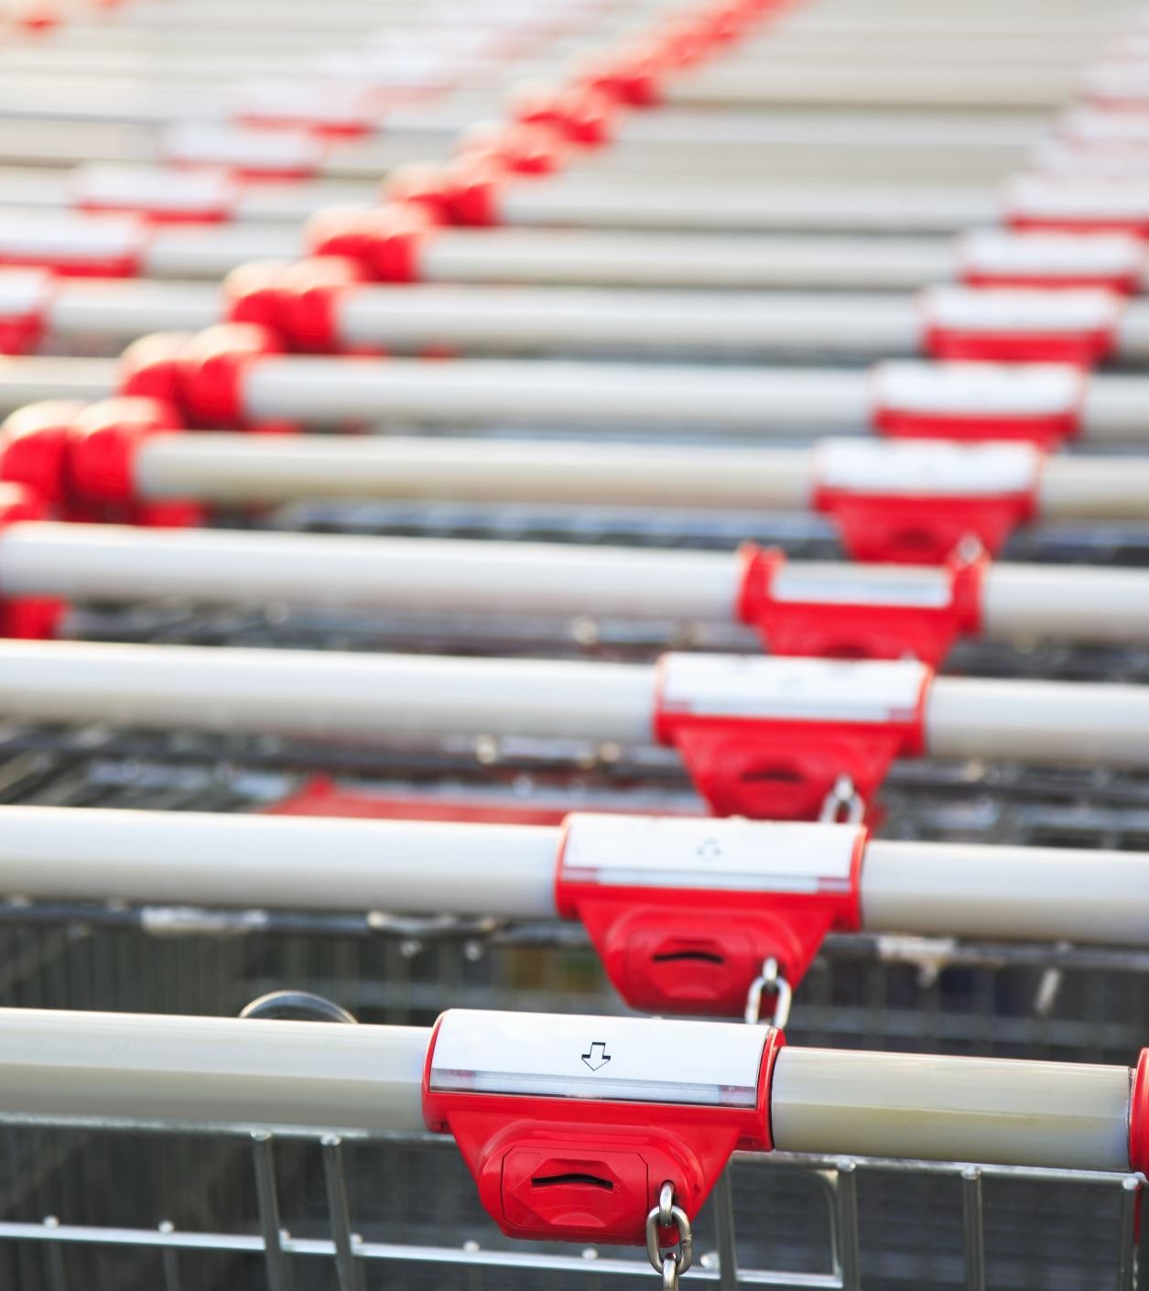
Possible recommendations
Consumer price & inflation sensitivity​
Costco should reinforce its current low-margin pricing strategy, promote more of its in housebrand (Kirkland), and they can also increase the type of products that they sell in bulk.​
Increase in competition in membership and discounts offered​
To ensure that they don't lose their current consumers and attract more consumers, Costco should continue selling exclusive high-quality goods, provide customers with an exceptional shopping experience, and maintain renewal rates that won't feel like a financial burden (Financial Contest, 2025)

Slide 30
Possible recommendations (continued)
The demand for convenience and the implementation for e-commerce
Even though they won't be able to match their competitor's speed immediately, they should consider offering the "click-and-collect" pick up option, partner up with other companies that would be able to carry out same-deliveries, and they can also improve their online product selection (AInvest, 2025)
Global sourcing risks and supply chain disruptions
Not being able to control the product shipment, and having no influence in speeding the shipping process, the drastic increase of transportation costs, tensions that arise from political events/leaders, and being reliant on international suppliers.

Slide 31
How to out compete
Costco

Slide 32
Convenience
The way to out compete Costco is to win in convenience
  As they are a membership warehouse model they do not have convenient sizing.
  Costco requires you to buy in bulk in order to save money.
  Costco is not inclusive to smaller families or single people you having to buy large amounts of perishables at a time.

Slide 33
Variety
Costco limits variety, this is done intentionally to keep things simple when they restock. They have to go through less vendors to get their products at a wholesale eligible price.

Slide 34
Target Middle Class Families
Everyone knows the status behind a Costco Membership.
  Create similar competing brands to take on Kirkland

Slide 35
Online
Mobile app
Personalized advertisements
Monthly/Bi-weekly replenishments

Slide 36
Margins
Plain and simple we cannot beat Costco in their margins.
  Costco is the king of slim margins
  Costco makes their money off of memberships not products

Slide 37
References
AInvest
Costco's E-Commerce Acceleration: A Blueprint for Long-Term Competitive Dominance and Margin Resilience
Financial Contest
Costco Wholesale Corporation (COST): A Deep Dive into the Warehouse Giant’s Enduring Appeal and Future Trajectory | FinancialContent

Slide 38
THANK YOU

