Slide 1
Case Analysis: Costco
Amber, Aylor, Ethan, John, Parker

Slide 2
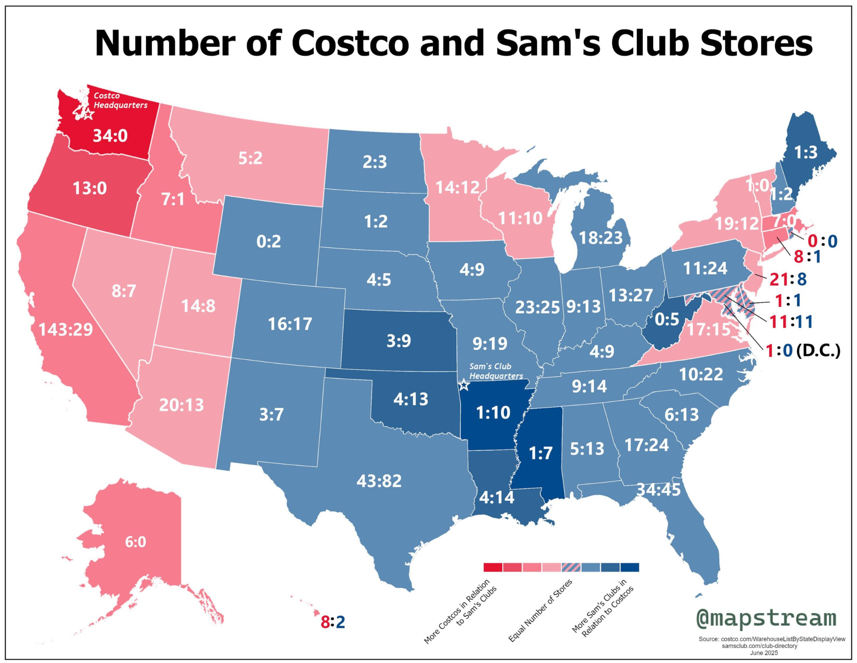
Table of Contents
Analysis of past financial performance
  Financial Ratios
  Common Size Analysis & Percent Change
Strategic Analysis
Factors & Challenges
Methods to beat Cosco

Slide 3
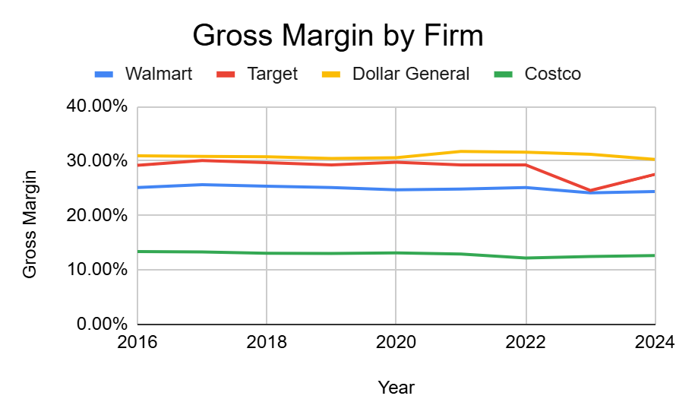
Profitability: Gross Margin
Gross margins are consistent overtime
Costco has the lowest markups out of the firms
Slight reductions in Target margins as a result of markup reductions

Slide 4
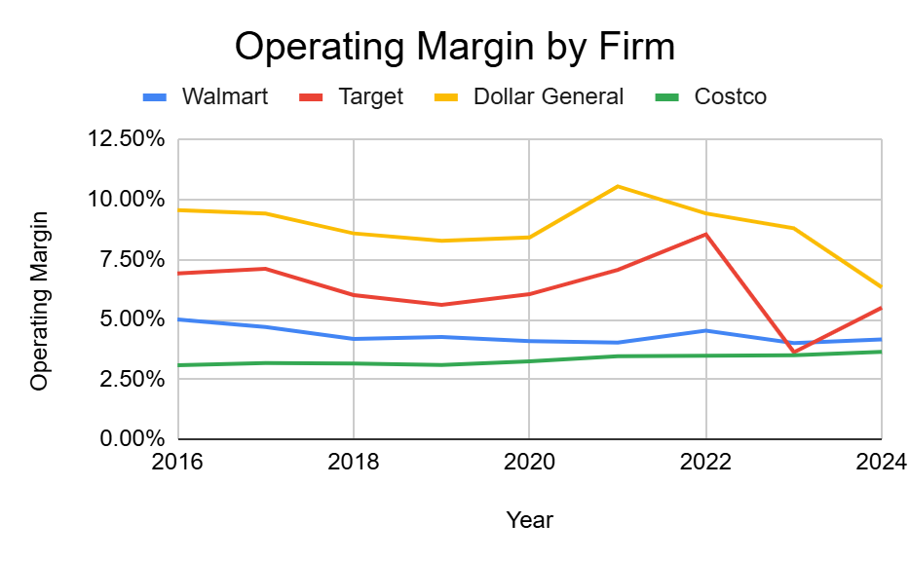
Profitability: Operating Margin
Unlike gross margin, operating margins do appear non-stationary
Two clusters:
  Dollar General & Target
  Walmart & Costco
Convergence in operating margins via reductions in Dollar General and Target’s margins.
Compared to gross margin Costco’s strength appears to be very low operating costs.

Slide 5
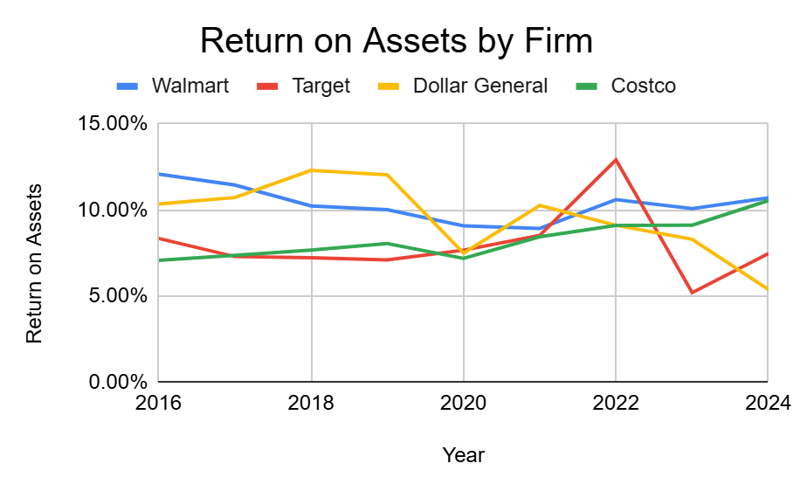
Profitability: Return on Assets
All firms except for Costco have had ROA decrease overtime.
Costco & Walmart appear to be be utilizing assets more efficiently than competitors.
What Costco lacks in margins it makes up for in scale.

Slide 6
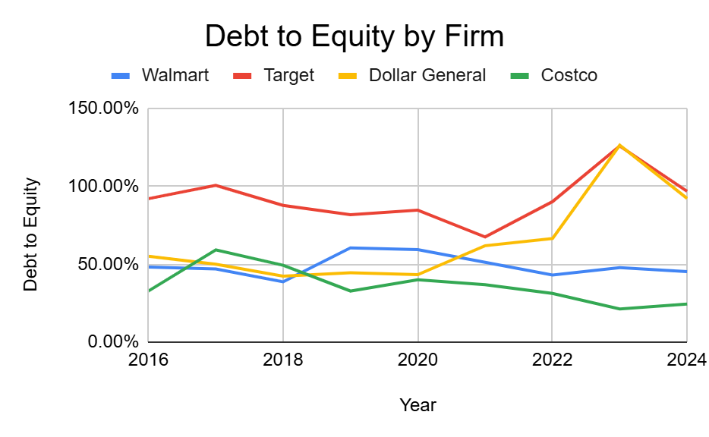
Leverage: Debt to Equity
Appearance of two clusters:
  Target & Dollar General (high D/E)
  Costco & Walmart (low D/E)
Dollar General debt issuance
  Done to open more stores in rural and low income areas
  Borrowing mostly done during post-pandemic
Costco
  Slight deleveraging
  Debt at highly sustainable levels

Slide 7
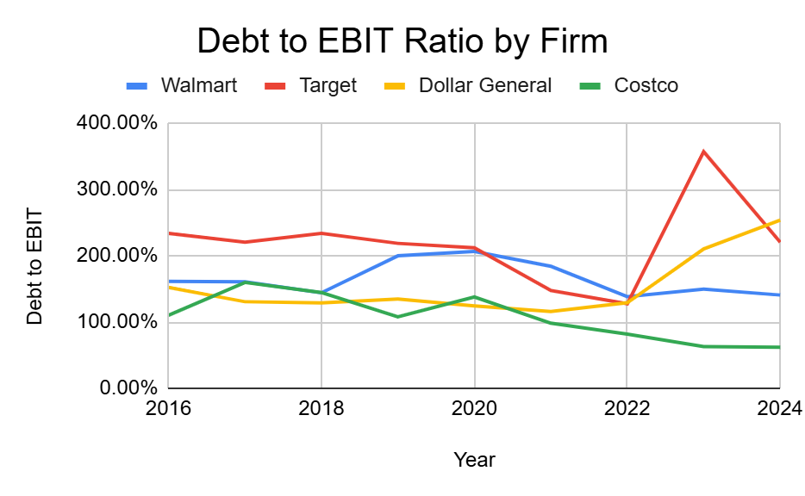
Leverage: Debt to EBIT
All firms are well within low-moderate debt levels.
  Highest debt/EBIT ratio is Dollar General at 254% which can be easily managed.
Costco carries very little debt
  Debt/EBIT is 62.40%, indicating a very low debt burden, and conservative financial management.
Same two apparent clusters

Slide 8
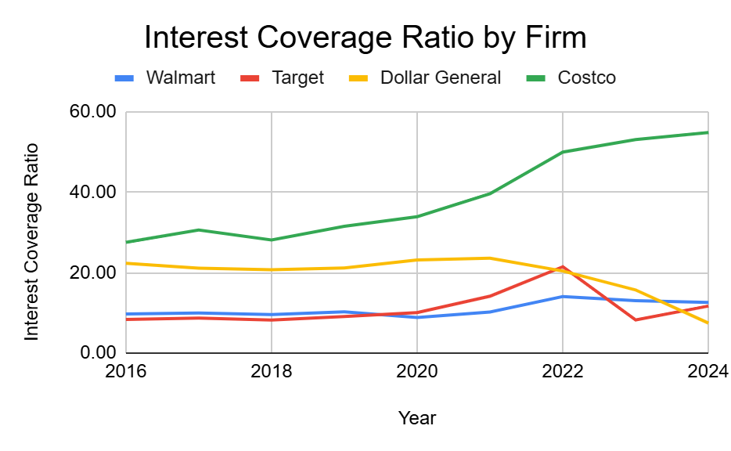
Leverage: Interest Coverage
Costco: A clear outlier
  Interest coverage at 54.94
  Other firms average 10.63
  Costco has the ability to take a lot more debt if it so chooses to
All interest coverage ratios display sound credit conditions

Slide 9
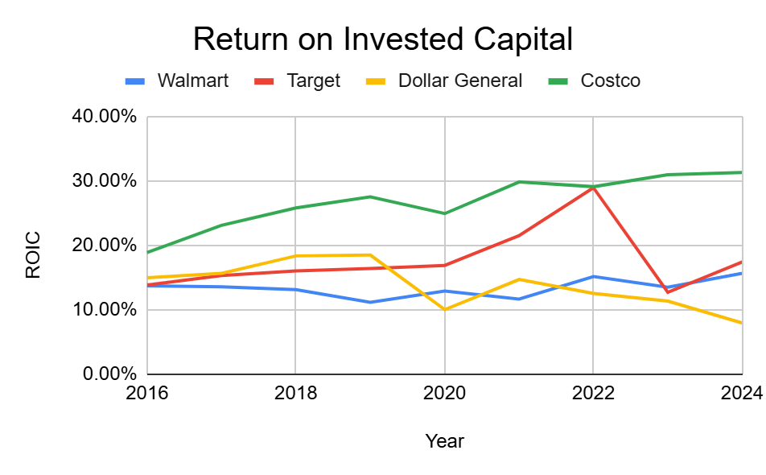
Efficiency: ROIC
Costco:
  Stable monotonic increases in ROIC
  More than double the average ROIC of competitors
Target:
  Departure and then return to the mean
Dollar General & Walmart:
  Relatively stable ROIC’s

Slide 10
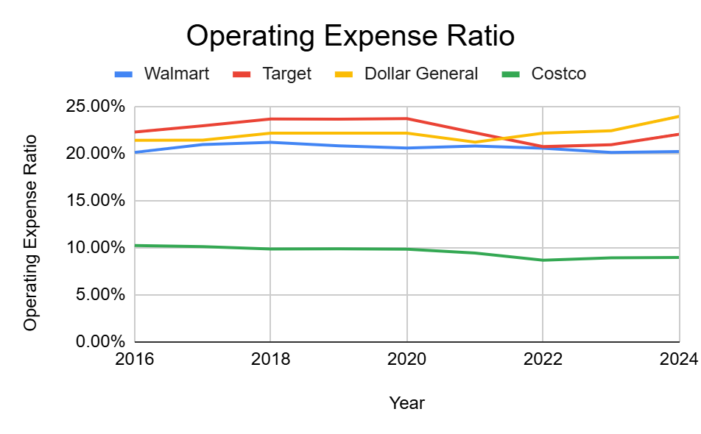
Efficiency: Operating Expense Ratio
Costco:
  Operating expense ratio far lower than peers and clear outlier.
  Showcases strong operational efficiency and strength to business model.
  Allows for very low markups.
Firms excluding Costco have roughly the same OER.

Slide 11
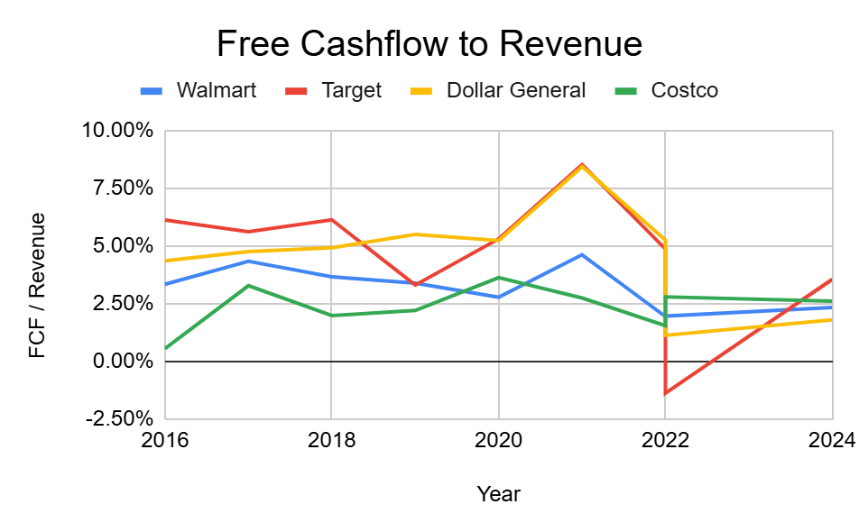
Efficiency: FCF / Revenue
Ratios relatively clustered
All three firms now have roughly the same FCF conversion.

Slide 12
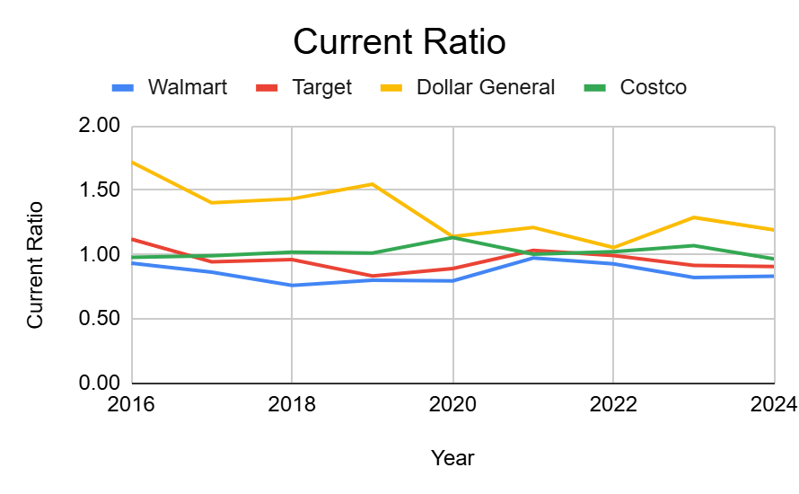
Liquidity: Current Ratio
All firms except for Dollar General have stable Current Ratios hovering around zero.
Dollar General maintains the highest level of broad liquidity compared to peers.

Slide 13
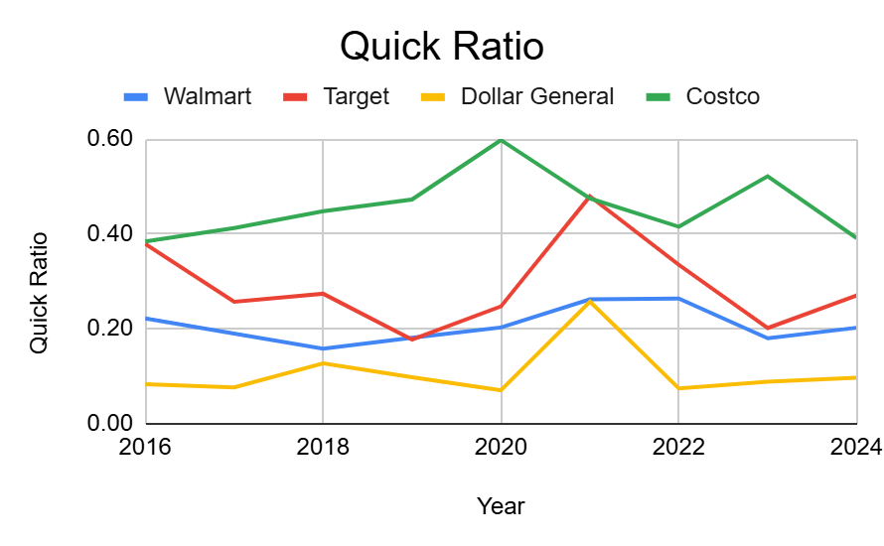
Liquidity: Quick Ratio
Most of Dollar General’s current assets consist of inventory
Costco has the highest quick-ratio
Quick ratios are relatively stationary

Slide 14
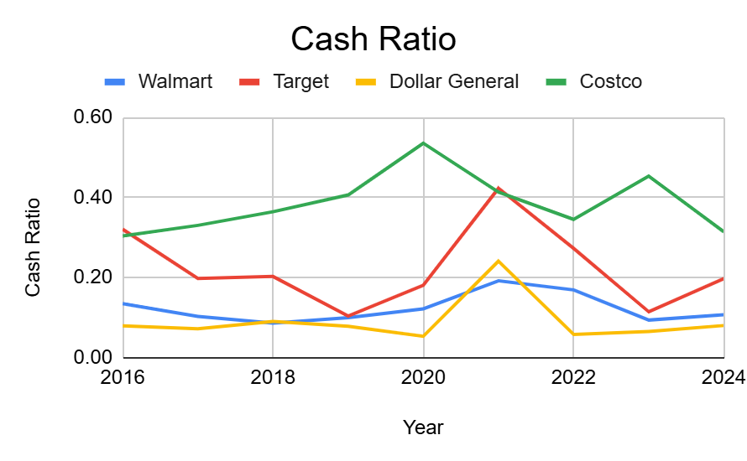
Liquidity: Cash Ratio
Almost the exact same as Quick Ratio
  Indicates very few marketable securities that are not cash equivalents

Slide 15
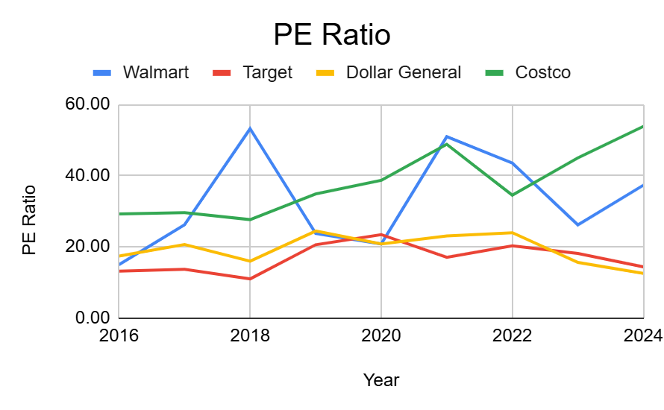
Market Value: PE Ratio
Two apparent clusters
  Costco & Walmart
    Increasing PE ratio
  Target & Dollar General
    Stable PE ratios
Markets expect higher growth from Walmart & Costco

Slide 16
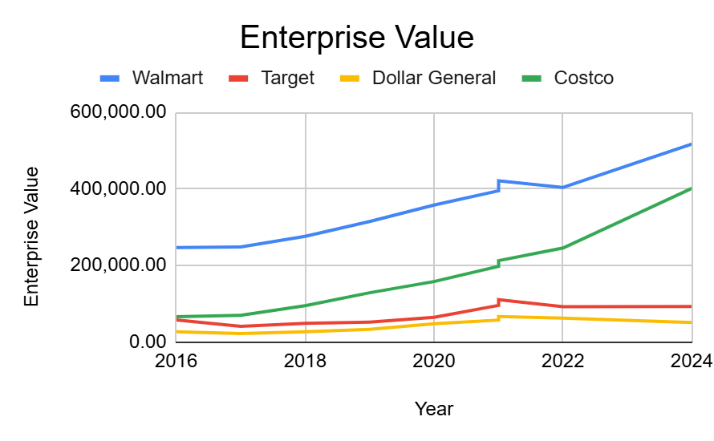
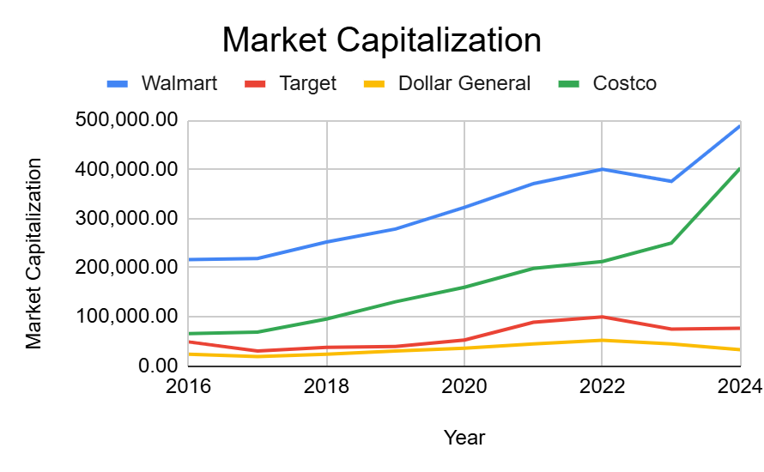
Market Value: Market Capitalization & EV
Costco has shown the most growth
  Catching up to Walmart and is second largest retailer
Target & Dollar General
  Stagnation in market capitalization

Slide 17
Conclusions from Financial Ratios
Walmart
  Second lowest markups and operating margins
  Efficient use of assets
  Relatively low debt levels and sound credit conditions
Target
  Higher markups
  Stagnant growth
Dollar General
  Higher markups
  Stagnant growth
Costco
  Extremely efficient use of assets and very good operational efficiency
  Posits very higher levels to additional debt capacity
  Rapid growth

Slide 18
Walmart Common Size Analysis
Year | 2016 | 2017 | 2018 | 2019 | 2020 | 2021 | 2022 | 2023 | 2024
Total Revenue | 100.00% | 100.00% | 100.00% | 100.00% | 100.00% | 100.00% | 100.00% | 100.00% | 100.00%
Cost Of Goods Sold | 74.87% | 74.35% | 74.63% | 74.90% | 75.31% | 75.17% | 74.90% | 75.86% | 75.62%
Gross Profit | 25.13% | 25.65% | 25.37% | 25.10% | 24.69% | 24.83% | 25.10% | 24.14% | 24.38%
Selling General & Admin Exp. | 20.13% | 20.96% | 21.19% | 20.83% | 20.59% | 20.80% | 20.57% | 20.13% | 20.21%
Other Operating Exp., Total | 20.13% | 20.96% | 21.19% | 20.83% | 20.59% | 20.80% | 20.57% | 20.13% | 20.21%
Operating Income | 5.00% | 4.69% | 4.18% | 4.27% | 4.10% | 4.03% | 4.53% | 4.01% | 4.17%
Interest Expense | -0.53% | -0.49% | -0.47% | -0.46% | -0.50% | -0.41% | -0.35% | -0.35% | -0.41%
Interest and Invest. Income | 0.02% | 0.02% | 0.03% | 0.04% | 0.04% | 0.02% | 0.03% | 0.04% | 0.08%
Net Interest Exp. | -0.51% | -0.47% | -0.44% | -0.41% | -0.46% | -0.39% | -0.32% | -0.31% | -0.33%
Other Non-Operating Inc. (Exp.) |  |  |  | 0.00% | 0.02% | 0.00% | -0.02% | 0.02% | 0.12%
EBT Excl. Unusual Items | 4.49% | 4.22% | 3.75% | 3.85% | 3.65% | 3.64% | 4.19% | 3.73% | 3.96%
EBT Incl. Unusual Items | 4.49% | 4.22% | 3.02% | 2.23% | 3.84% | 3.68% | 3.26% | 2.78% | 3.37%
Income Tax Expense | 1.36% | 1.28% | 0.92% | 0.83% | 0.94% | 1.23% | 0.83% | 0.94% | 0.86%
Net Income to Company | 3.13% | 2.94% | 2.10% | 1.40% | 2.90% | 2.45% | 2.43% | 1.85% | 2.51%
Minority Int. in Earnings | -0.08% | -0.13% | -0.13% | -0.10% | -0.06% | -0.04% | -0.05% | 0.06% | -0.12%
Net Income | 3.05% | 2.81% | 1.97% | 1.30% | 2.84% | 2.42% | 2.39% | 1.91% | 2.39%

Slide 19
Dollar General Common Size Analysis
Year | 2016 | 2017 | 2018 | 2019 | 2020 | 2021 | 2022 | 2023 | 2024
Revenue | 100.00% | 100.00% | 100.00% | 100.00% | 100.00% | 100.00% | 100.00% | 100.00% | 100.00%
Other Revenue | 0.00% | 0.00% | 0.00% | 0.00% | 0.00% | 0.00% | 0.00% | 0.00% | 0.00%
Total Revenue | 100.00% | 100.00% | 100.00% | 100.00% | 100.00% | 100.00% | 100.00% | 100.00% | 100.00%
Cost Of Goods Sold | 69.04% | 69.15% | 69.23% | 69.55% | 69.41% | 68.24% | 68.40% | 68.77% | 69.71%
Gross Profit | 30.96% | 30.85% | 30.77% | 30.45% | 30.59% | 31.76% | 31.60% | 31.23% | 30.29%
Other Operating Exp., Total | 21.41% | 21.44% | 22.18% | 22.18% | 22.17% | 21.22% | 22.18% | 22.43% | 23.95%
Operating Income | 9.55% | 9.41% | 8.59% | 8.27% | 8.42% | 10.54% | 9.42% | 8.80% | 6.34%
Interest Expense | -0.43% | -0.44% | -0.41% | -0.39% | -0.36% | -0.45% | -0.46% | -0.56% | -0.84%
Net Interest Exp. | -0.43% | -0.44% | -0.41% | -0.39% | -0.36% | -0.45% | -0.46% | -0.56% | -0.84%
EBT Incl. Unusual Items | 9.10% | 8.94% | 8.13% | 7.87% | 7.93% | 10.09% | 8.95% | 8.24% | 5.48%
Income Tax Expense | 3.38% | 3.25% | 1.57% | 1.66% | 1.76% | 2.22% | 1.94% | 1.85% | 1.18%
Earnings from Cont. Ops. | 5.72% | 5.69% | 6.56% | 6.20% | 6.17% | 7.87% | 7.01% | 6.38% | 4.29%
Net Income to Company | 5.72% | 5.69% | 6.56% | 6.20% | 6.17% | 7.87% | 7.01% | 6.38% | 4.29%

Slide 20
Target Common Size Analysis
Year | 2016 | 2017 | 2018 | 2019 | 2020 | 2021 | 2022 | 2023 | 2024
Total Revenue | 100.00% | 101.23% | 101.29% | 101.24% | 101.27% | 101.26% | 101.33% | 100.00% | 100.00%
Cost Of Goods Sold | 70.80% | 70.80% | 71.22% | 71.61% | 71.13% | 71.62% | 71.66% | 75.43% | 72.46%
Gross Profit | 29.20% | 30.43% | 30.07% | 29.63% | 30.14% | 29.64% | 29.67% | 24.57% | 27.54%
Selling General & Admin Exp. | 19.62% | 20.29% | 20.88% | 20.97% | 20.96% | 20.07% | 18.77% | 18.76% | 19.80%
Depreciation & Amort. | 2.67% | 2.95% | 3.10% | 2.99% | 3.06% | 2.41% | 2.24% | 2.19% | 2.25%
 | 0.00% | 0.00% | 0.00% | 0.00% | 0.00% | 0.00% | 0.00% | 0.00% | 0.00%
Other Operating Exp., Total | 22.28% | 23.24% | 23.98% | 23.95% | 24.01% | 22.48% | 21.01% | 20.94% | 22.05%
Operating Income | 6.91% | 7.20% | 6.09% | 5.68% | 6.13% | 7.15% | 8.66% | 3.63% | 5.49%
Interest Expense | -0.82% | -0.82% | -0.74% | -0.62% | -0.61% | -0.50% | -0.40% | -0.44% | -0.47%
Net Interest Exp. | -0.82% | -0.82% | -0.74% | -0.62% | -0.61% | -0.50% | -0.40% | -0.44% | -0.47%
EBT Excl. Unusual Items | 6.09% | 6.38% | 5.35% | 5.06% | 5.48% | 6.62% | 8.28% | 3.19% | 5.03%
EBT Incl. Unusual Items | 6.67% | 5.71% | 5.06% | 4.94% | 5.43% | 6.00% | 8.51% | 3.13% | 4.93%
Income Tax Expense | 2.17% | 1.87% | 1.01% | 1.00% | 1.19% | 1.27% | 1.87% | 0.58% | 1.08%
Earnings from Cont. Ops. | 4.50% | 3.84% | 4.05% | 3.94% | 4.24% | 4.73% | 6.64% | 2.55% | 3.85%
Net Income | 4.56% | 3.94% | 4.06% | 3.95% | 4.25% | 4.73% | 6.64% | 2.55% | 3.85%

Slide 21
Costco Common Size Analysis
Year | 2016 | 2017 | 2018 | 2019 | 2020 | 2021 | 2022 | 2023 | 2024
Revenue | 100.00% | 100.00% | 100.00% | 100.00% | 100.00% | 100.00% | 100.00% | 100.00% | 100.00%
Cost Of Goods Sold | 86.68% | 86.71% | 86.99% | 87.02% | 86.91% | 87.12% | 87.85% | 87.58% | 87.39%
Gross Profit | 13.32% | 13.29% | 13.01% | 12.98% | 13.09% | 12.88% | 12.15% | 12.42% | 12.61%
Selling General & Admin Exp. | 10.17% | 10.04% | 9.80% | 9.82% | 9.83% | 9.42% | 8.66% | 8.91% | 8.96%
Other Operating Exp., Total | 10.23% | 10.10% | 9.85% | 9.88% | 9.83% | 9.42% | 8.66% | 8.91% | 8.96%
Operating Income | 3.09% | 3.19% | 3.16% | 3.10% | 3.26% | 3.47% | 3.49% | 3.51% | 3.65%
Interest Expense | -0.11% | -0.10% | -0.11% | -0.10% | -0.10% | -0.09% | -0.07% | -0.07% | -0.07%
Interest and Invest. Income | 0.03% | 0.04% | 0.05% | 0.08% | 0.05% | 0.02% | 0.03% | 0.19% | 0.21%
Net Interest Exp. | -0.08% | -0.07% | -0.06% | -0.02% | -0.04% | -0.07% | -0.04% | 0.13% | 0.14%
Currency Exchange Gains (Loss) | 0.02% | 0.00% | 0.02% | 0.02% | 0.00% | 0.03% | 0.05% | 0.01% | 0.01%
Other Non-Operating Inc. (Exp.) | 0.01% | 0.01% | 0.02% | 0.02% | 0.00% | 0.02% | 0.02% | 0.01% | 0.03%
EBT Excl. Unusual Items | 3.05% | 3.13% | 3.14% | 3.12% | 3.22% | 3.45% | 3.51% | 3.66% | 3.83%
Income Tax Expense | 1.05% | 1.03% | 0.89% | 0.69% | 0.78% | 0.82% | 0.85% | 0.91% | 0.93%
Earnings from Cont. Ops. | 2.00% | 2.10% | 2.25% | 2.43% | 2.43% | 2.59% | 2.61% | 2.60% | 2.90%
Net Income to Company | 2.00% | 2.10% | 2.25% | 2.43% | 2.43% | 2.59% | 2.61% | 2.60% | 2.90%

Slide 22
Common Size Analysis 2024
Item | Walmart | Target | Dollar General | Costco
Revenue | 100.00% | 100.00% | 100.00% | 100.00%
Other Revenue | 0.00% | 0.00% | 0.00% | 0.00%
Total Revenue | 100.00% | 100.00% | 100.00% | 100.00%
Cost Of Goods Sold | 75.62% | 72.46% | 69.71% | 87.39%
Gross Profit | 24.38% | 27.54% | 30.29% | 12.61%
Other Operating Exp., Total | 20.21% | 22.05% | 23.95% | 8.96%
Operating Income | 4.17% | 5.49% | 6.34% | 3.65%
Interest Expense | -0.41% | -0.47% | -0.84% | -0.07%
Net Interest Exp. | -0.33% | -0.47% | -0.84% | 0.14%
EBT Incl. Unusual Items | 3.37% | 4.93% | 5.48% | 3.83%
Income Tax Expense | 0.86% | 1.08% | 1.18% | 0.93%
Earnings from Cont. Ops. | 2.51% | 3.85% | 4.29% | 2.90%
Net Income to Company | 2.51% | 3.85% | 4.29% | 2.90%

Slide 23
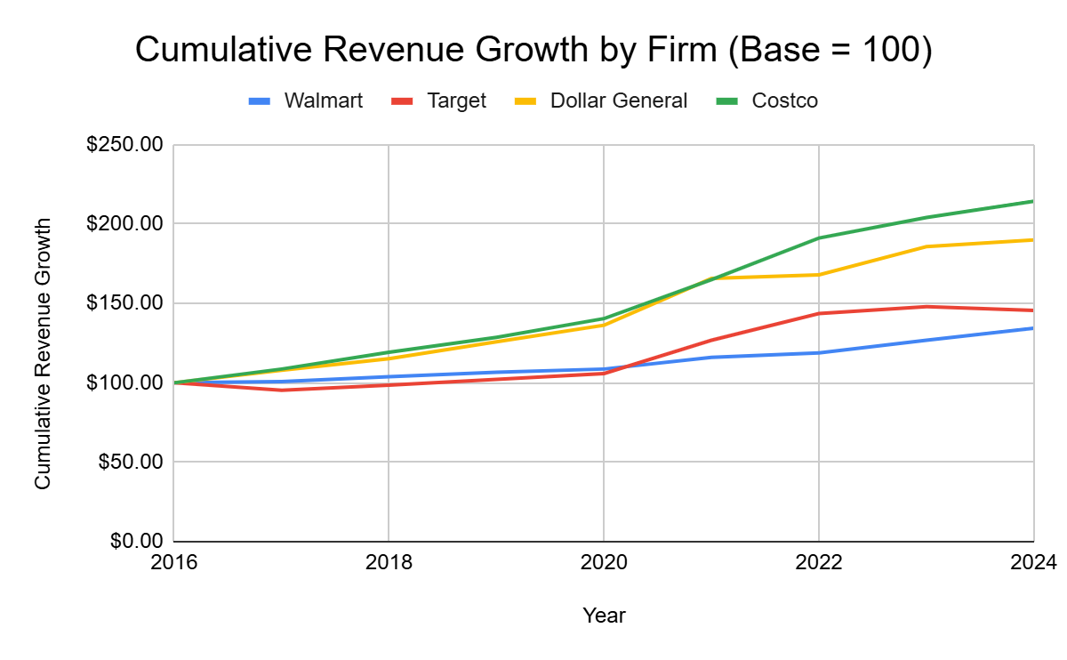
Percent Change Analysis: Cumulative Revenue Growth
Costco & Dollar General
  Revenues more than doubled from 2016-2024
  Less mature firms
Target & Walmart
  Slow growth
    Participation in inflation
  Likely due to firm maturity

Slide 24
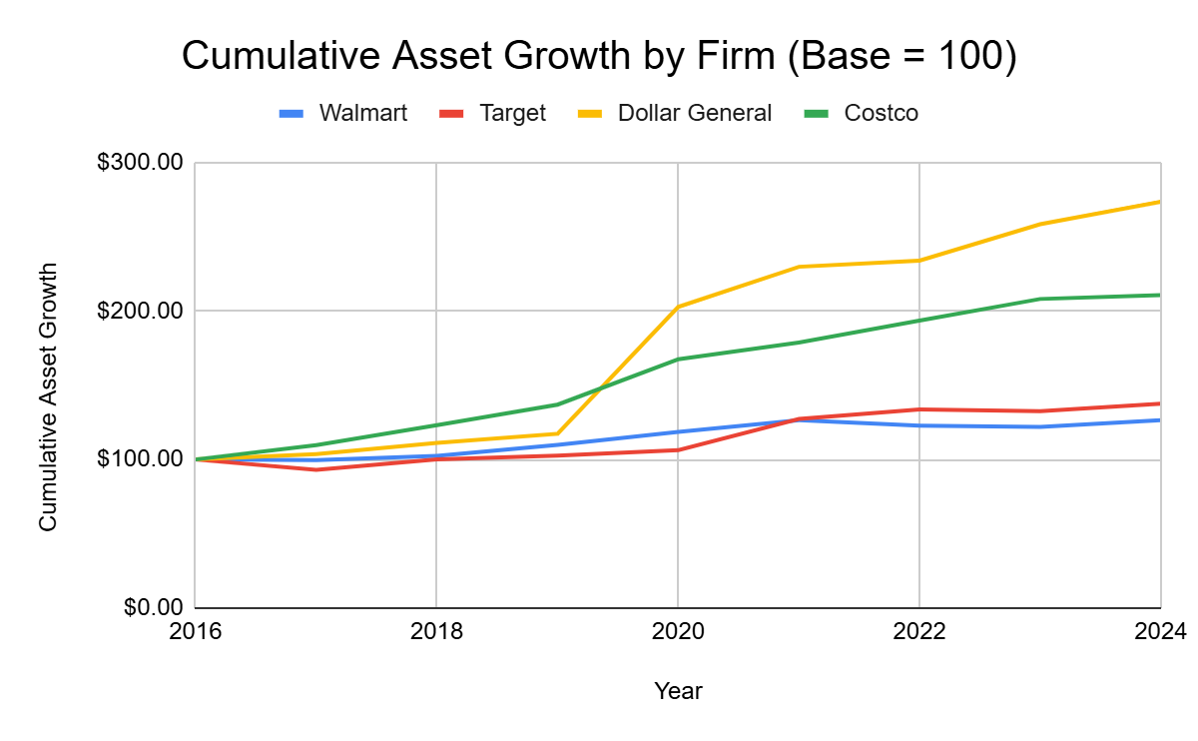
Percent Change Analysis: Cumulative Asset Growth
Dollar General & Costco
  Large asset expansion
    Especially Dollar General
  Dollar General’s jump in 2019
    Change in corporate strategy
      Focus on rural areas
Walmart & Target
  Very slow asset growth

Slide 25
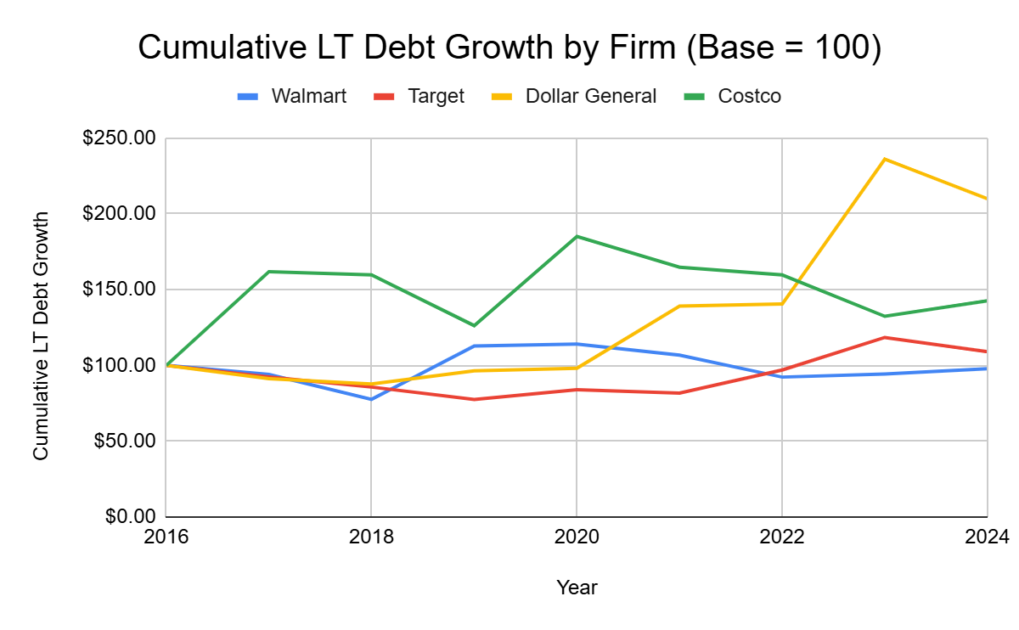
Percent Change Analysis: Cumulative LT Debt Growth
Costco & Dollar General
  Costco:
    Initial rise in debt
    Subsequent decrease
  Dollar General:
    Large increase in debt since 2016
Walmart & Target
  Stable debt levels

Slide 26
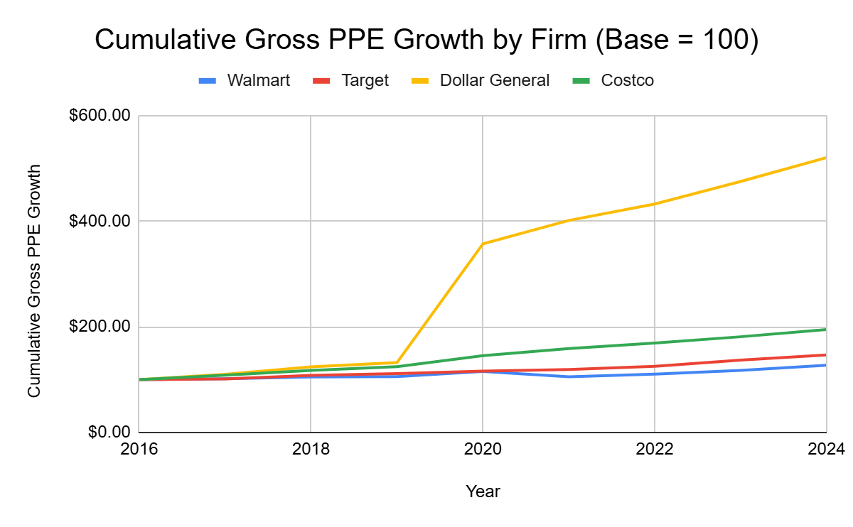
Percent Change Analysis: Cumulative Gross PPE Growth
Dollar General’s massive PPE expansion
  Shift in strategy in 2019
  Mostly debt financed
  Non-organic
Costco
  Has acquired more stores
  Organic
Walmart & Target
  Low PPE expansion
  Likely already due to maturity

Slide 27
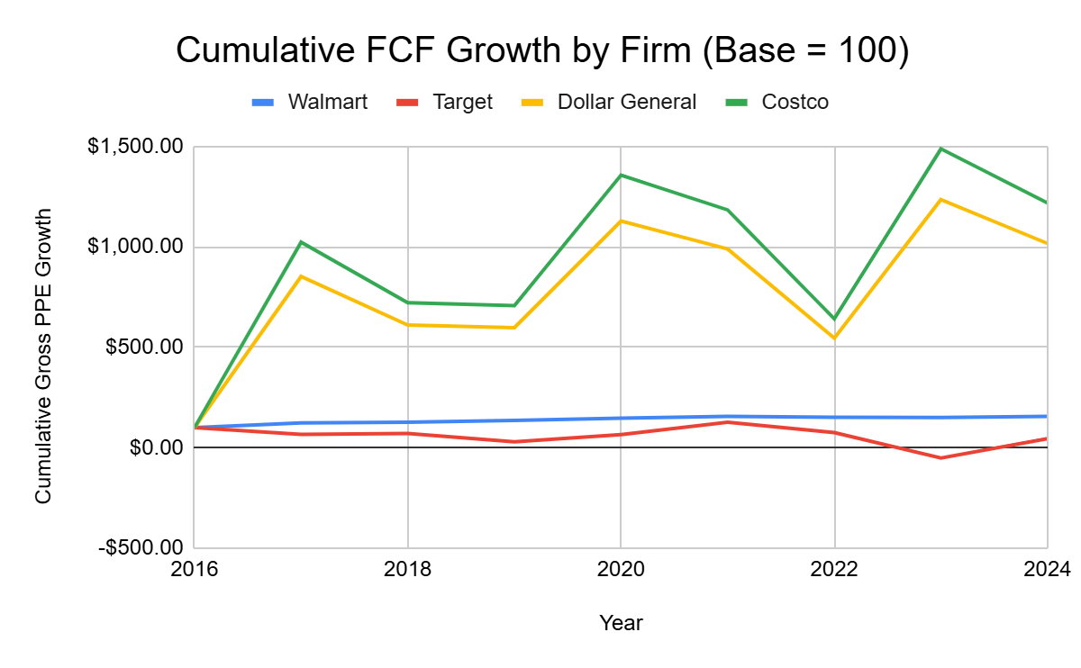
Percent Change Analysis: Cumulative FCF Growth
Costco & Dollar General
  Massive growth in FCF (10x)
  Costco’s growth appears to be more organic
  Dollar General’s appears to be more inorganic
Walmart & Target
  Target appears to be struggling to maintain existing FCF
  Walmart has seen a steady increase (100 to 150).

Slide 28
Conclusions
Walmart & Target
  Slow asset & PPE growth
  Stable cash flows reflective of firm maturity
Costco & Dollar General
  Large asset and PPE growth
  Inorganic vs Organic growth
  Costco benefits from “organic growth”
Increase in Total Debt
Costco | Dollar General
92.77% | 509.00%

Slide 29
Current Strategies
Costco prioritizes membership fees over product margins. By capping markups at 14% (vs. 24-40% for typical retailers), they drive extreme customer loyalty and membership renewals.
Bulk-only packaging to reduce unit costs
Annual membership model
14%
Maximum Price Markup
Notes:
The 14% Rule: Explain that Costco could charge more, but they choose not to. This cap is their “brand promise.”
Membership fees sometimes make up two-thirds or more of its net operating income in recent years.

Slide 30
Strategies: Minimal Operating Costs
Warehouse Efficiency
Facilities: Concrete floors and simple lighting reduce capital expenditures
Direct Floor Stocking: Forklifts deliver pallets directly to the floor to minimize labor costs
Cross- Docking: Trucks meet at hubs to reload same-day, ensuring full capacity and zero storage time
Notes:
Focus on the warehouse design. Mention that they don’t pay for pretty shelves or individual stocking.
Explain Cross-Docking: Goods don’t sit in a backroom; they go from the manufacturer’s truck to Costco’s floor in the same day.

Slide 31
Strategies: Inventory and Pricing
SKU Discipline
Costco carries only 4,000 SKUs compared to 40,000 at typical grocery stores. This limited selection increases volume per item and negotiating power with vendors.
Vendor Negotiation
They demand production savings be passed to their customers. By ordering simple variations (e.g., one color/ply), manufacturers reduce production line switches.
Notes:
Highlight the 4,000 SKUs. Since they only buy one type of ketchup or one type of toothpaste for example, they are the vendor’s most important customer.
Mention the Kimberly Clark example: one ply, one print = cheaper manufacturing for them, lower prices for us

Slide 32
Strengths
High Efficiency
Costco claims the best operating efficiency in the business, managing margins down to the basis point in their reports.
Private Label Power
Kirkland Signature provides high-quality, low-cost alternatives that fill market gaps and increase member value.
Management Stability
Consistent leadership (Sinegal and Brotman) since founding, unlike competitors with high management turnover.

Slide 33
Weaknesses
Lower Visit Frequency: Members visit roughly 9 times per year, compared to 12 times per year for BJ’s Wholesale
Vulnerable Gross Margins: Relying on extremely low markups means even minor operating cost spikes can threaten profitability
Hyper-Limited Selection: The 4,000 SKU limit may alienate customers looking for specific niche brands or varieties
Notes:
Visit Frequency: Usually because Costco stores are further away or only have “bulk” items
Selection: Not many options, especially if you want a specific or niche brand

Slide 34
Challenges in the Retail Industry
Market Saturation
Competition for the same middle-class customer is intensifying, especially as Sam’s Club moves into the same markets as Costco.
Supply Chain Disintegration
While Costco reduces vendor margins, they also face lower profits throughout the supply chain, which could lead to vendor pushback.
Notes:
By squeezing vendors, Costco might limit the overall profitability of its own partners
As competitors improve their atmosphere (like BJ’s lighting and flooring), Costco’s look might start to feel too basic or not the best experience for some people.

Slide 35
Recommendations for Future Growth
Additional Services
Expand gas, pharmacy, and tire centers to make the warehouse a “one-stop shop” for all household needs.
High-End Diversification
Leverage their success in wine and jewelry to attract higher income members and boost sales per store.
Price Stability
Maintain the 14% markup cap even under inflation to differentiate strictly from standard retailers.

Slide 36
How to Beat Costco

Slide 37
Costco’s Vulnerabilities
Lower Visit Frequency
Small Selection
Thin Margins
Notes:
In order to beat Costco, one cannot simply copy it verbatim. Their business model revolves around very small markups, membership loyalty, and efficiency of operations. Trying to beat those would be an uphill battle. Instead, the strategy should attack areas where Costco is not as strong. Our analysis showed that costco has 3 main vulnerabilities: low visit frequency, small selection, and relies heavily on bulk buys. Most costco customers visit the store only 9 times per year, which leaves an opening for the casual everyday shopping. In order to beat costco, one must focus on being convenient, able to be frequently visited, and flexbile.

Slide 38
Costco’s Strategy
Has a hard cap on markups at 14%
Only uses bulk packaging
Has only 4,000 SKUs vs 40,000+ at other stores
Notes:
Costco only keeps about 4,000 SKUs in stock, compared to the staggering 40,000 at other grocery stores. That limited selection helps Costco lower costs, but that also means that customers are limited in finding the brands and sizes that they might typically enjoy. Competitors like Walmart, Target, or Sam’s Club can beat Costco by offering a larger variety of items, which could include multiple brands, multiple cost tiers, and more local products. Costco is also only a warehouse-style store, which can allow competitors to beat it by offering more services like curbside pickup, same-day delivery, or easy returns. Adding features like these will increase the frequency of shopping and phase out bulk buying.

