Slide 1

Analysis:
The Costco Wholesale Case
Net Present Legends:
Alex Cox, Carson Rowenhorst, Joey Burke, Van Tling

Slide 2
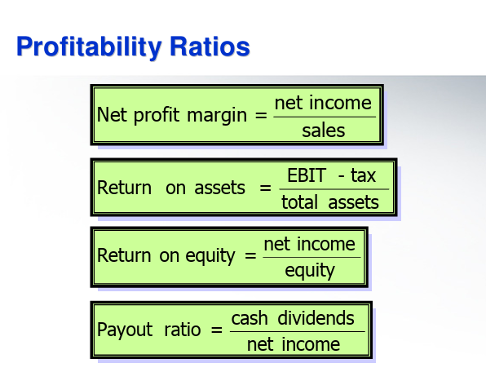
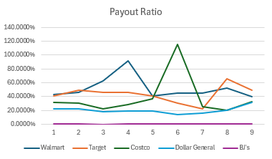
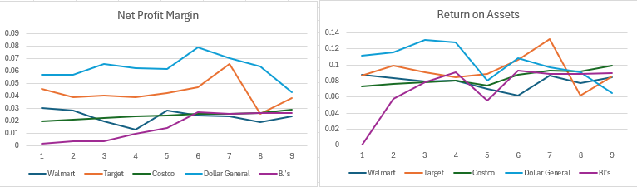
Profitability

Slide 3
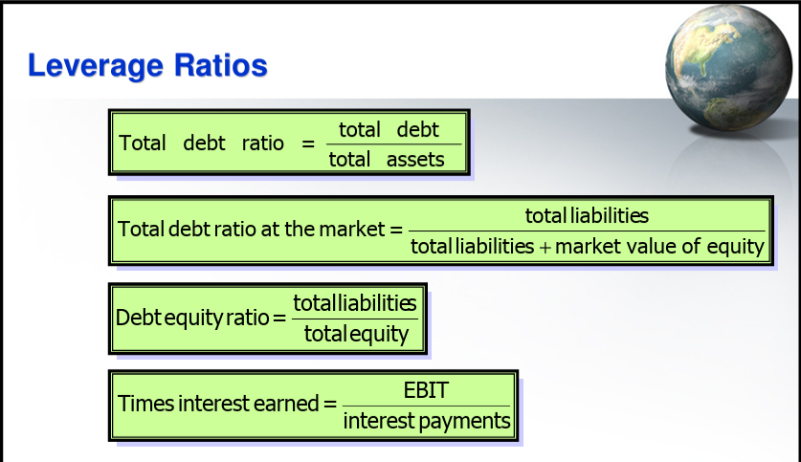
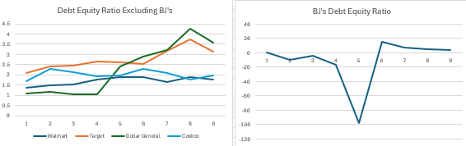
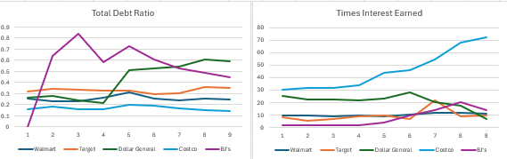
Leverage

Slide 4
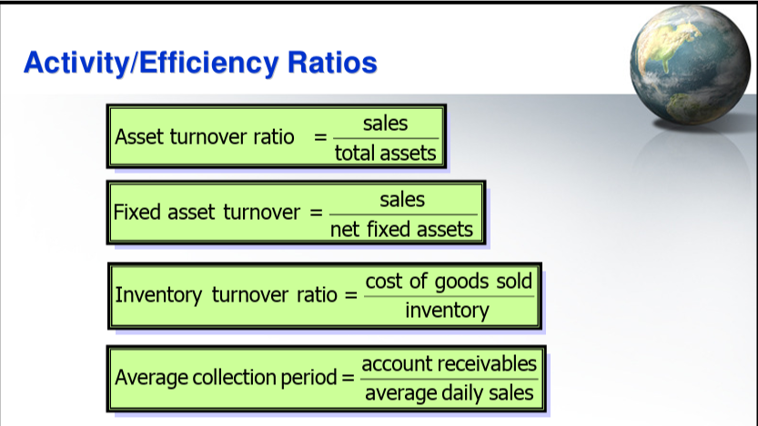
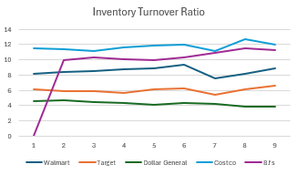
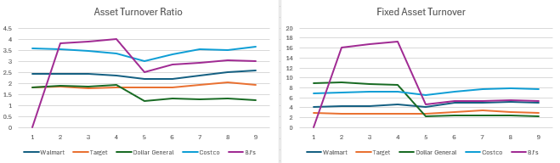
Efficiency

Slide 5
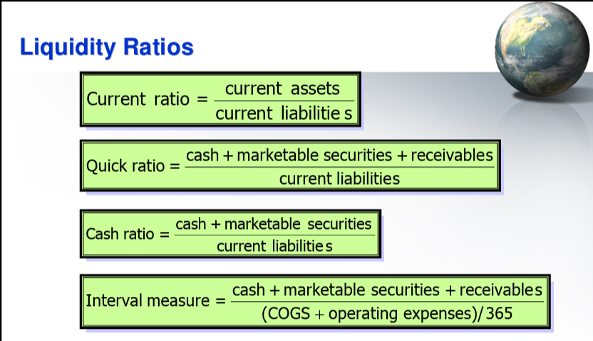
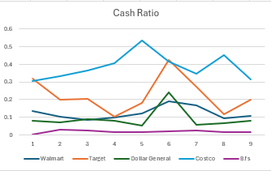
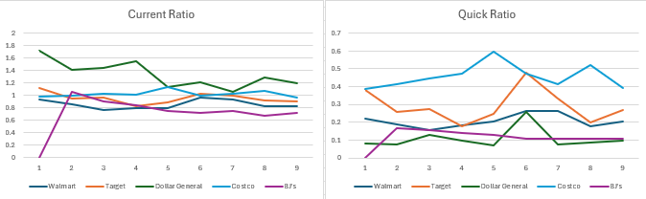
Liquidity

Slide 6
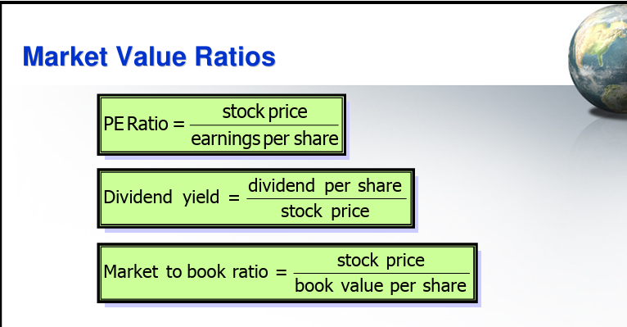
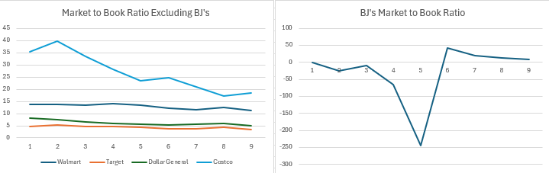
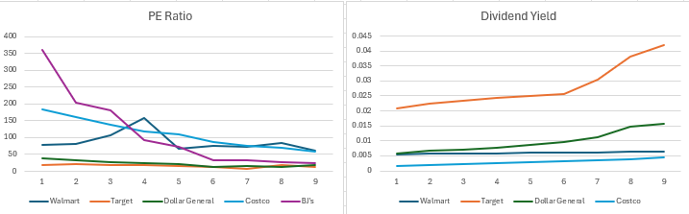
Market Value

Slide 7
Financial Ratios Discussion
Profitability
  Profits are consistent and have low volatility
  Shows Costco values sustainable, predictable profitability
Leverage
  Ratios show that Costco generally maintains lower financial risk compared to its competitors
  Lower reliance on debt financing, therefore reducing interest payments
  Further shows Costco’s strategy of long-term stability and risk management
Efficiency
  Overall, extremely efficient and outperforms competitors in each metric
  Can convert assets into sales more efficiently than the competition
  Reinforces the idea that Costco's operational model and efficiency are an imperative competitive advantage
Liquidity
  Relatively liquid, so they can meet their short-term financial obligations
  Balances operational efficiency with financial flexibility, so they can handle economic downturns as well
Market Value
  A high and consistent PE ratio means investors are willing to pay more today for Costco's future earnings
  Costco’s good performance is a sign of strong and stable future growth, low risk, and predictable earnings
Overall, Costco outperforms its competition not by maximizing short-term profitability, but by being focused on the long run, performing consistently, achieving operational efficiency, and maintaining a conservative financial structure. Costco's stability and long-term value creation explains their strong market valuation compared to its competitors.
Notes:
Profitability: Costco's profitability stands out because of its consistency and low volatility. While it might not be the highest for each profitability measure, the low volatility and consistency makes their profitability still a strength. Additionally, their profits, while lower than some competitors, consistently increases over time. Overall, the results from the profitability measures show that Costco values sustainable, predictable profitability over short-term margins
Leverage: The leverage ratios indicate that Costco, generally, maintains lower financial risk compared to its competitors. Based on the total debt ratio especially, it is shown that Costco relies less on debt financing, which reduces interest payments (which can be seen on their times interest earned). Although more debt financing can enhance returns during strong economic periods, it also increases risk. Therefore, Costco being more conservative when it comes to leveraging aligns with its strategy of long-term stability and risk management.
Efficiency: Overall, Costco is extremely efficient, outperforming its competitors in three out of three of the graphs. This means that Costco has a very high inventory turnover, meaning it can convert assets into sales faster. This reinforces the idea that Costco's operational model and efficiency is an imperative competitive advantage
Liquidity: Relative to its peers, Costco maintains a strong short-term financial position, shown by them having the highest quick ratio and cash ratio and the second highest current ratio. This means that Costco is very able to meet their short-term obligations. The results also show that Costco does a good job at balancing operational efficiency with financial flexibility, so that they could handle economic downturns well.
Market Value: Costco's market valuation relative to its competitors performs very well. For example, their PE ratio is almost the highest and is the most consistent, meaning that investors are willing to pay more today for Costco's future earnings, which is a sign of strong and stable future growth, low risk, and predictable earnings. Additionally, Costco's has the lowest dividend yield, which likely means that their stock price has risen faster than its dividends and Costco reinvests into their operations and prioritizes growth.
Overall: Costco outperforms its competition not by maximizing short-term profitability, but by being focused on the long run, performing consistently, operational efficiency, and conservative financial structure. Costco's stability and long-term value creation explains their strong market valuation compared to its competitors.

Slide 8
Costco consistently operates with the highest COGS ratio
Firms show stable COGS percentages over time
Target and Walmart exhibit more variability

Slide 9
Costco’s gross margin remains structurally lower and extremely stable
Dollar General consistently posts the highest gross margins
Target shows the most volatility

Slide 10
Costco demonstrates the strongest operating expense performance
Dollar General’s rising operating expense ratio indicates weakening cost efficiency
Target’s operating expense performance improves after 2020

Slide 11
Dollar General delivers the strongest operating income performance overall
Target’s operating income performance is the most volatile
Costco’s operating income performance remains low but extremely stable

Slide 12
Costco shows the strongest financing performance
Dollar General’s interest expense performance deteriorates after 2022
BJ’s and Target improve financing performance over time

Slide 13
Dollar General delivers the strongest net income performance overall
Target’s net income performance is the most volatile
Costco’s net income performance steadily improves over time

Slide 14
Costco demonstrates the strongest liquidity performance
Target’s cash performance is highly volatile
BJ’s and Dollar General operate with minimal cash buffers

Slide 15
BJ’s exhibits the weakest working-capital performance
Costco maintains strong receivables performance
Dollar General shows the most efficient receivables performance

Slide 16
Target exhibits the weakest balance-sheet performance
Dollar General demonstrates the strongest capital structure performance
Costco’s liability performance remains moderate and stable

Slide 17
Costco and Walmart exhibit the strongest equity performance
BJ’s equity performance improves materially after 2020
Dollar General’s equity performance deteriorates sharply after 2019

Slide 18
Takeaways from Common-Size Charts
Costco’s performance is marked by consistency not the widest margins
Costco consistently maintains the lowest operating expenses as a percentage of revenue
Costco’s profitability performance is low but steadily improving
Costco combines strong liquidity with conservative leverage

Slide 19
CostCo's Current Strategies
Membership Model
Low Product Markup
Limited Selection Strategy
Bulk Packaging Advantage
Notes:
To understand Costco more, we have to look at the four strategic pillars.
First, Membership Model: Costco isn’t just a store; it’s a subscription service. Membership fees account for the vast majority of their operating profit. This ‘pre-paid’ revenue allows them to sell high-quality goods almost at cost.
Second, Low Product Markup: Costco doesn’t just match prices: they set them. They have a rule; no item is marked up more than 14%, while traditional retailers mark up their items from 20-40%.
Third, Limited Selection Strategy: Costco offers a limited selection of 4,000 SKUs. By narrowing the choice, they maximize their buying power. When Costco buys, they buy so much of one single item that they can effectively dictate the price to the supplier.
Finally, Bulk Purchasing Advantages: By selling in bulk, they move products 2x faster than rivals. They often sell an item and get paid by a member before they even have to pay the supplier.

Slide 20
Strengths
Unbreakable Loyalty
Labor Productivity
Efficiency
Operational Speed
Notes:
This leads us to their core strengths.
The biggest is Loyalty: In 2026, their renewal rate is about 92%. Their profits come from membership fees.
Operational Speed: Costco maintains an inventory turnover of 12%. This means they sell their entire inventory about every 30 days. They’re collecting cash for members at the register at the same time, or even before the bill from the supplier is due.
Efficiency: Their stores are warehouses, not showrooms. Products stay on shipping pallets, eliminating the labor cost of stocking individual shelves. The employees are cross-trained as well, so they are trained to do 3 or 4 different jobs.
Labor Productivity: By paying the highest wages in retail, they have the lowest turnover. An experienced Costco worker is twice as productive as a new hire at a competitor, moving more merchandise per labor hour than anyone else in the industry.

Slide 21
Weaknesses
Digital Gap
Demographic
Supply Chain Reliance
Geographic
Notes:
However, no company is perfect. Costco’s model is built on you walking into a warehouse. They have been slower than Amazon and Walmart in overall digital infrastructure and speed.
Geographic: Most sales come from the U.S., Canada, and Mexico since it's most concentrated in North America, leaving them vulnerable to regional economic shifts. They don’t have enough stores in other parts of the world to make up the difference if the North American economy slows down.
Demographic: Costco’s bulk-buying model was built for suburban families with large garages and SUVs. However, Gen Z shoppers are increasingly moving into smaller urban apartments with zero storage space.
Supply Chain Reliance: Costco’s biggest strength – carrying only 4,000 SKUs—is also a major weakness. Because they have a few backups, they are dangerously dependent on a handful of major suppliers

Slide 22
Threats To Supermarket Industry
Low Profit Margins
High Dependency On Memberships
High Price Competition
Scale And Size

Slide 23
Low Profit Margins
Margins profit margin on goods are 1-2%
High fixed costs limited downside protection

Slide 24
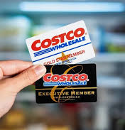
Memberships Are Driving Force
Membership fees account for 1.7-2% of total revenue
Accounts for all net profit
Very Low cancel Rate

Slide 25

High Price Competition
Price competition limits margin expansion
Cost savings passed to consumers, not retained
Industry growth closely tied to GDP

Slide 26
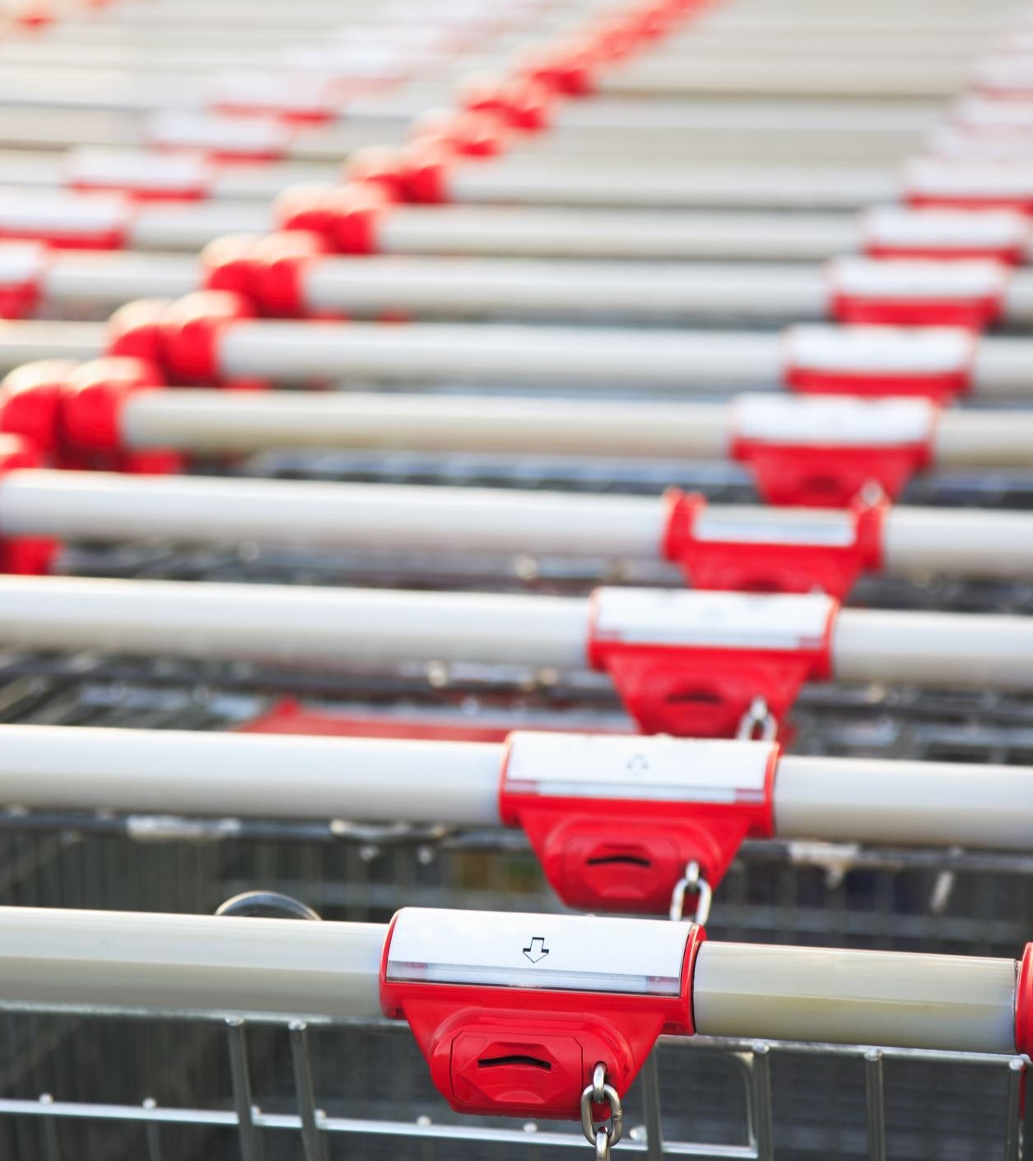
How To Scale When Market Is Saturated?
Large Retailers Have Hundreds Of Locations
Sams Club 500+ CostCo 300+
Scale lowers per-unit purchasing and distribution costs
Purchasing Power

Slide 27
Protect Membership Model
Continue using membership fees as the primary profit driver while giving the best in store experience
Membership fees represented only 1.7–2.0% of revenue, yet accounted for most or all net income
Actions
Implement gradual membership fee increases when value perception is strong.
Expand member-only benefits (exclusive SKUs, Kirkland extensions).
Maintain high renewal rates to stabilize earnings in a low-margin environment.

Slide 28
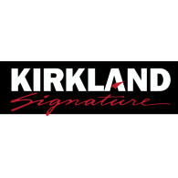
Leverage Kirkland to Support Growth
Expand Private Label
Kirkland Allows
Improved Margins
Customer Loyalty
Price Control
Actions
Introduce Kirkland in high-volume, repeat-purchase categories
Maintain strict quality standards to protect brand trust

Slide 29
How to Beat Costco
Take advantage of their weaknesses by:
Exploiting Costco’s technological gap
Targeting a different demographic
Different supply chain approach
Capitalize on areas that do not have a strong Costco presence
Notes:
Digital Gap:
Capitalize on Costco’s relative technological gap by developing a more seamless and user-friendly digital shopping experience. This includes investing in robust e-commerce capabilities such as home delivery, curbside pickup, and mobile features like scan-and-go to reduce in-store friction. Many competitors, including Sam’s Club and Target, have already adopted these technologies and are meeting customer expectations for speed and convenience. By prioritizing digital innovation, the firm can attract tech-savvy consumers and better serve customers who prefer omnichannel shopping options.
Demographic Strategy:
Rather than imitating Costco’s bulk-purchase model, which may be less appealing to younger shoppers or smaller households with limited storage space, the company should focus on offering products in smaller, more flexible package sizes. This approach aligns with the preferences of younger consumers, urban residents, and first-time households who value convenience, affordability, and reduced waste. Tailoring product sizes to this demographic can broaden the customer base and differentiate the firm from Costco’s traditional warehouse model.
Supply Chain Reliance:
Expand the assortment of SKUs to provide customers with a wider range of choices and reduce dependence on single suppliers. A broader product mix increases the likelihood that customers can find exactly what they are looking for and helps mitigate the risk of stockouts caused by supplier disruptions. Even when a specific item is unavailable, having close substitutes ensures customers still have viable purchasing options, improving satisfaction and maintaining sales continuity.
Geographic Expansion:
Pursue growth opportunities in regions where Costco has limited market penetration, particularly outside of North America. By entering underserved international markets, the company can avoid direct competition while capturing new demand. Success in these regions will require adapting product offerings, pricing, and marketing strategies to local consumer preferences and cultural norms. Understanding regional tastes and shopping behaviors can create a strong competitive advantage and support long-term global growth.

