Slide 1

Case
Analysis
CostCo
February 10, 2026
Net Prophets

Slide 2

Agenda
Introduction
Financial ratios
Common-Size and Percentage Change
Strategies
Industry Challenges
Outperforming CostCo

Slide 3

Introduction
Profits are up, and losses are down! We are very proud of the progress our team has made. ​
Today we’ll review our wins and losses from last year and give you an overview of what you can expect for next year.

Slide 4

Financial Ratios
Let’s dive in

Slide 5
Growth by sector

Slide 6
Growth by sector
 | Q1 | Q2 | Q3 | Q4
Series 1 | 4.3 | 2.5 | 3.5 | 4.5
Series 2 | 2.4 | 4.4 | 1.8 | 2.8
Series 3 | 2 | 2 | 3 | 5
Series 4 | 3.4 | 6 | 2.3 | 1

Slide 7
Common-Size and YoY Percentage Change
Let’s dive in

Slide 8
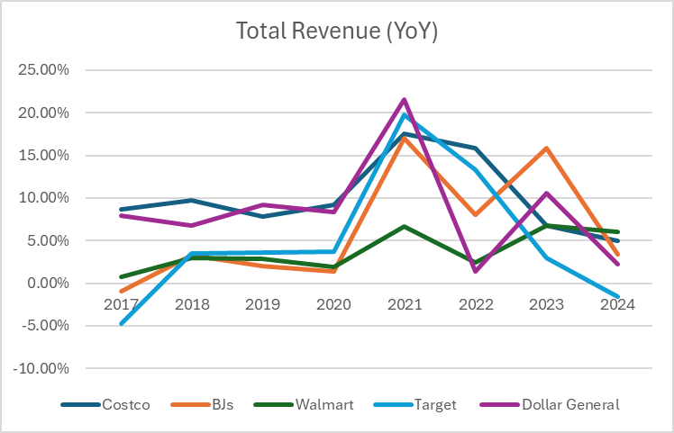
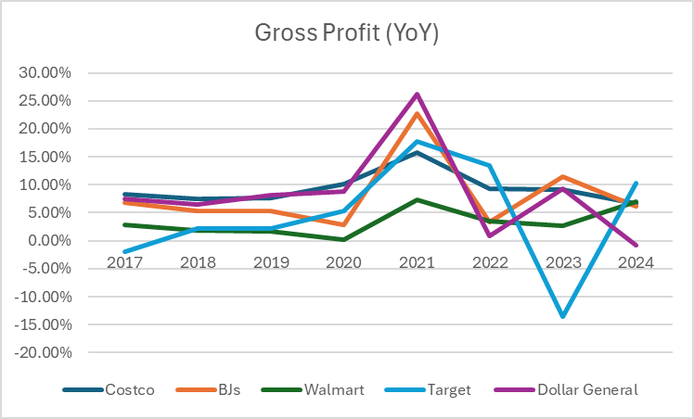

Slide 9
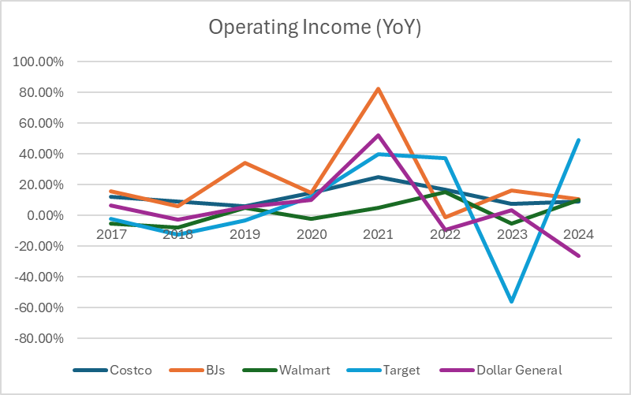

Slide 10
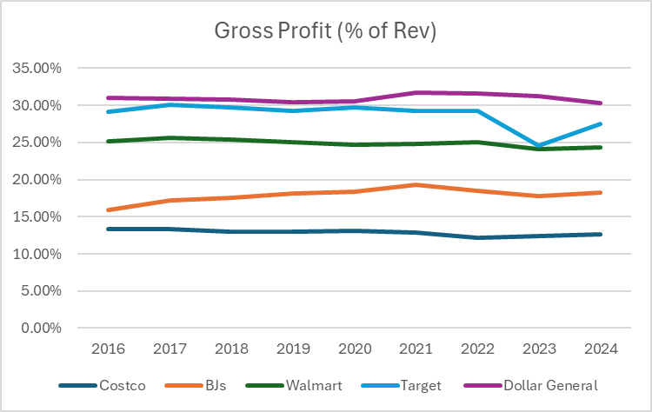
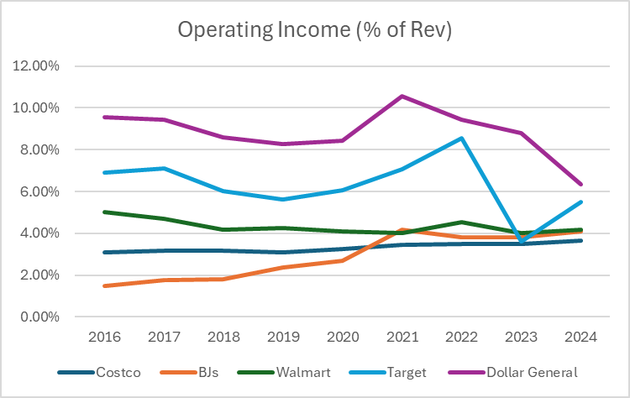

Slide 11
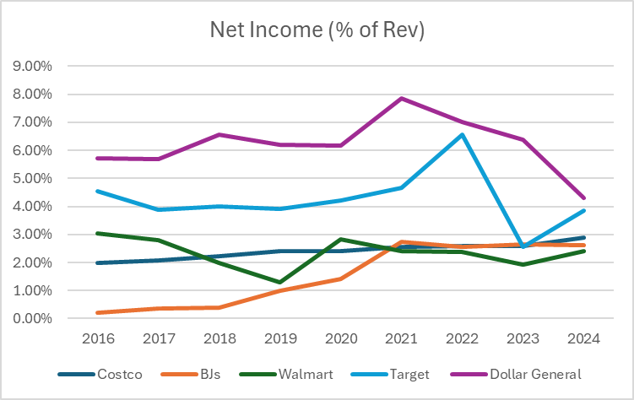

Slide 12
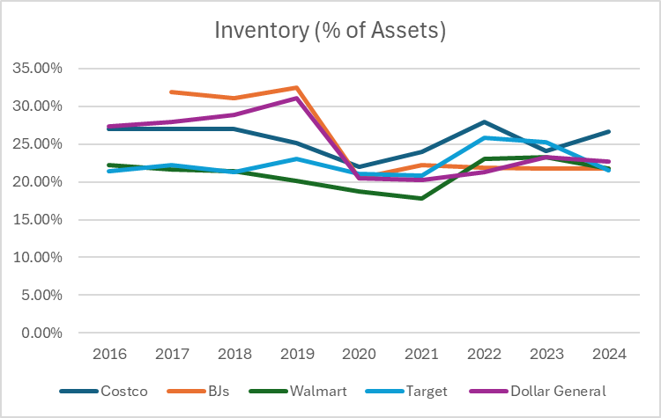
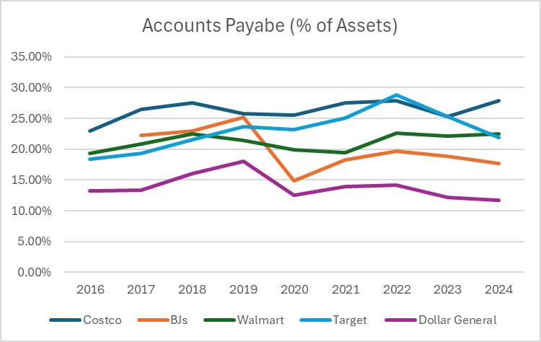

Slide 13
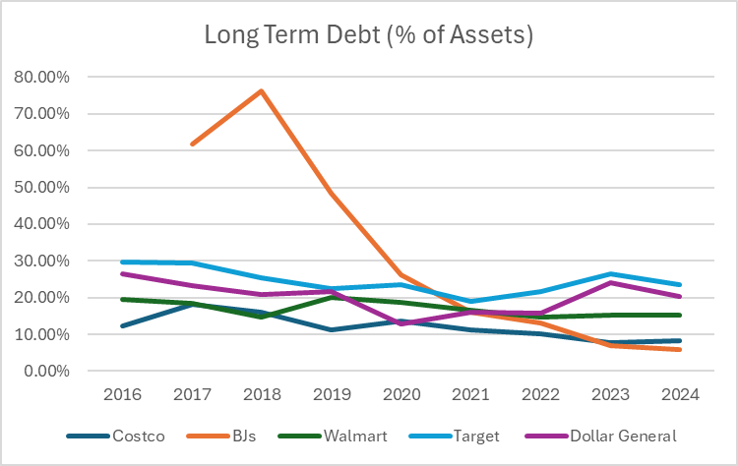
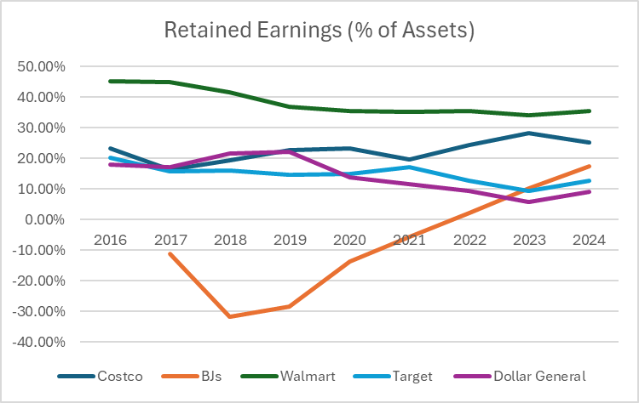

Slide 14
CostCo Strategies
Let’s dive in

Slide 15

Goals for Q1
Employee opportunities
Business priorities
End of fiscal celebration on July 15th
Employee day of learning on August 14th
Employee Yoga on September 3rd
Seminar series begins September 10th
Increase customer satisfaction by 2%
Maintain growth
Diversify investment in sector 2
Initiative partnership with 3rd party organizations

Slide 16
Industry Challenges
Let’s dive in

Slide 17
Retail Industry Threats
Price Competition
Omnichannel Expectations
Supply Chain Disruptions
Discount Retailers
Online giants
Inflation-driven consumer price sensitivity
Online shopping options
Fast and convenient delivery
Seamless integration with physical stores
Inventory volatility
Rising transportation and sourcing costs
Global supplier risks

Slide 18
Recommendations
Price Competition
Omnichannel Expectations
Supply Chain Disruptions
Expand the Kirkland Brand
Leverage membership fees
Enhance CostCo app and website
Expand delivery services
Integrate online and in-store experiences
Diversify suppliers and sourcing regions
Invest in data-driven demand forecasting
Expand and optimize distribution centers

Slide 19






Summary
We’re delivering for our customers
Last year we supported thousands of customers and sold 60,000 units
Our business is good
Profits are up in the last quarter by 3%
Our customers keep coming back
We increased customer retention by 4%
We’re getting our work done
We finished the consolidation project
Our team is growing
We welcomed 3 new team members
last quarter
We’re leaders
We are top leaders in the industry across
the board

Slide 20
Outperforming
CostCo
Let’s dive in

Slide 21

Conclusion
Thanks to your commitment and strong work ethic, we know next year will be even better than the last.
We look forward to working together.
Ana
Sales@contoso.com

