Slide 1
Intro case - Costco wholesale corp.
Blue Oval Consulting

Slide 7
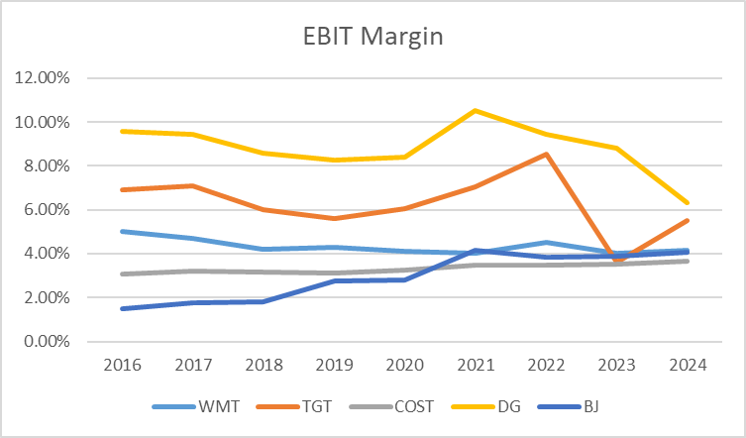
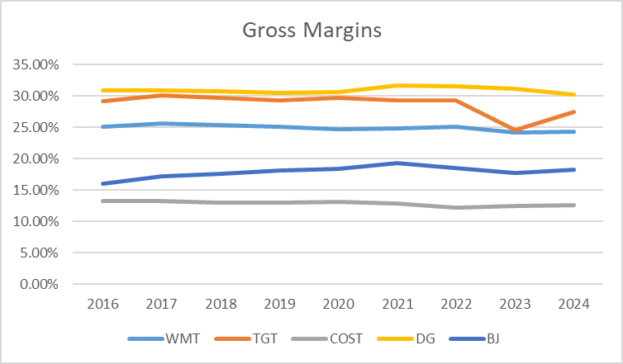

Slide 8
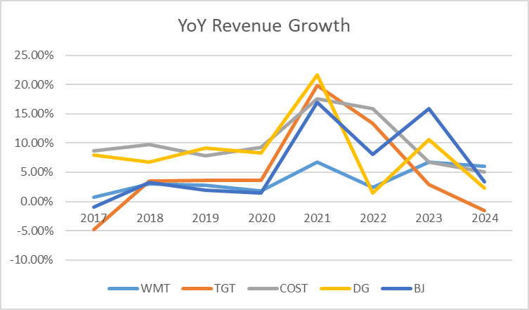
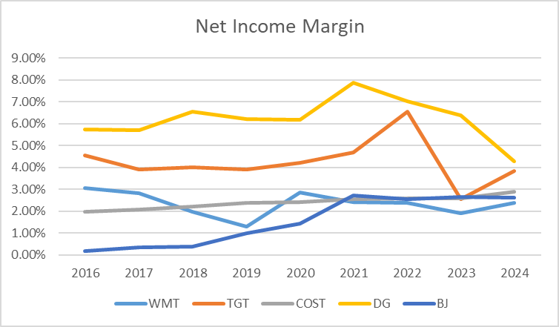
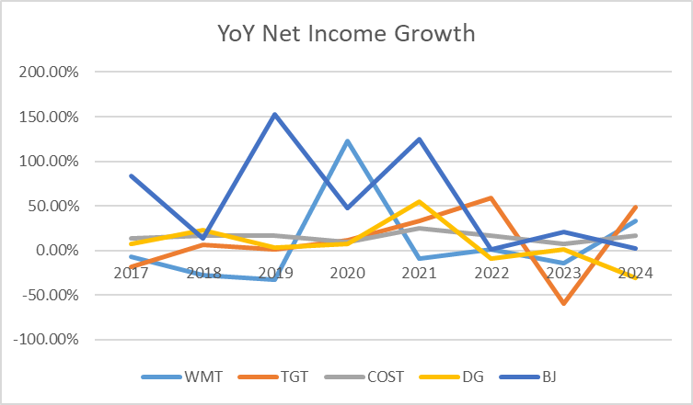

Slide 9
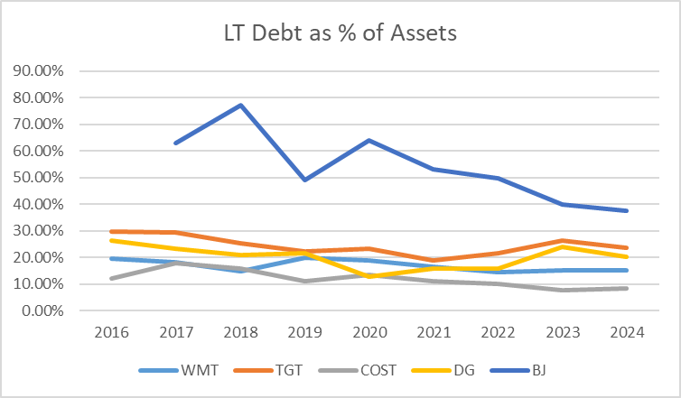
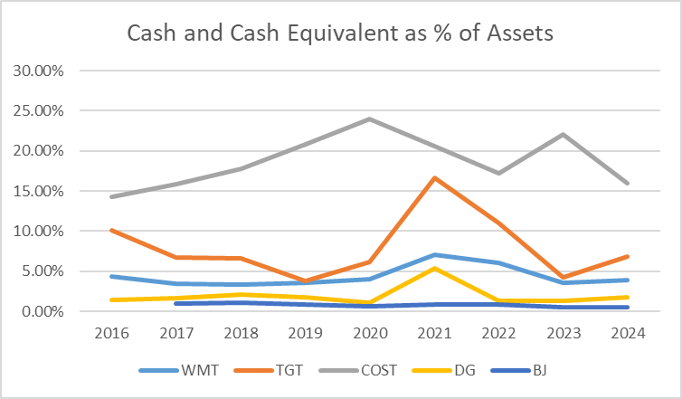
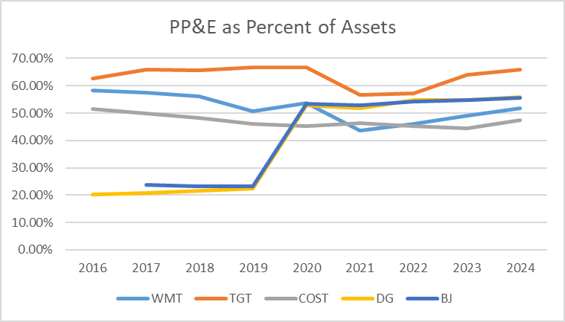

Slide 10
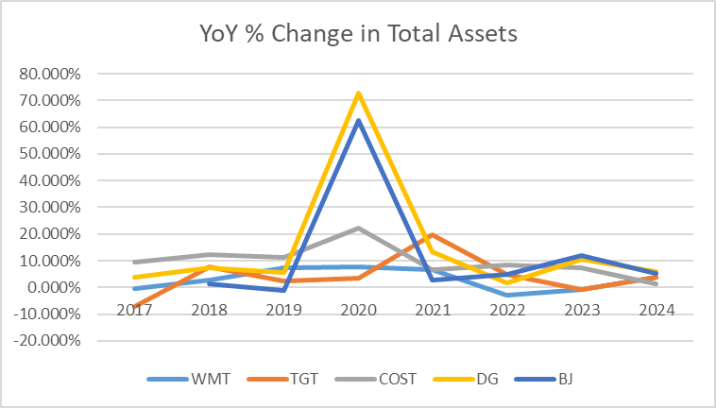
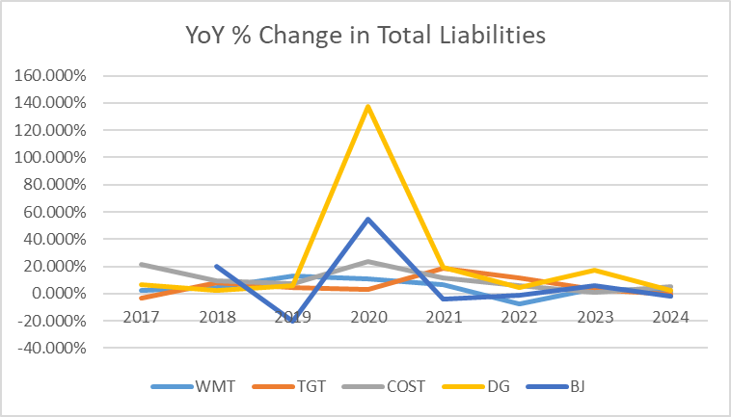

Slide 11
Costco's Current Strategy:
Provide customers with the lowest per unit price on products.
Strengths
Weaknesses
Limited markup
  Cap markup at 14%.
Little product differentiation from vendors
  Supply chain savings.
Pallet-to-Warehouse stocking strategy
  Pallet delivered direct to warehouse floor.
  Reduces labor costs from not having to stock items individually on shelves.
Memberships
  All the strengths above allow Costco to gradually raise membership prices over time.
Low operating margins
  Lower margin% than competitors like Dollar General and Target.
Weak e-commerce presence
  Losing out on e-commerce market compared competitors like Target and Amazon.

Slide 12
challenges/factors in the retail industry
Current challenges
Current factors
Price competition/price sensitivity
Declining consumer loyalty
  Promotions-driven loyalty is fragile
High overhead costs
Cost inflation
  Impacts labor, transportation
Fewer discretionary purchases
Constant consumer behavior shifts
Heavily saturated market
  More options for the consumer
Expansion opportunities
Supply chain volatility
Globalization

Slide 13
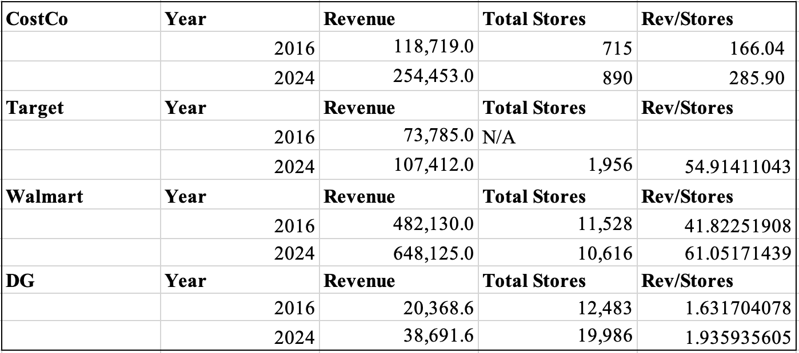
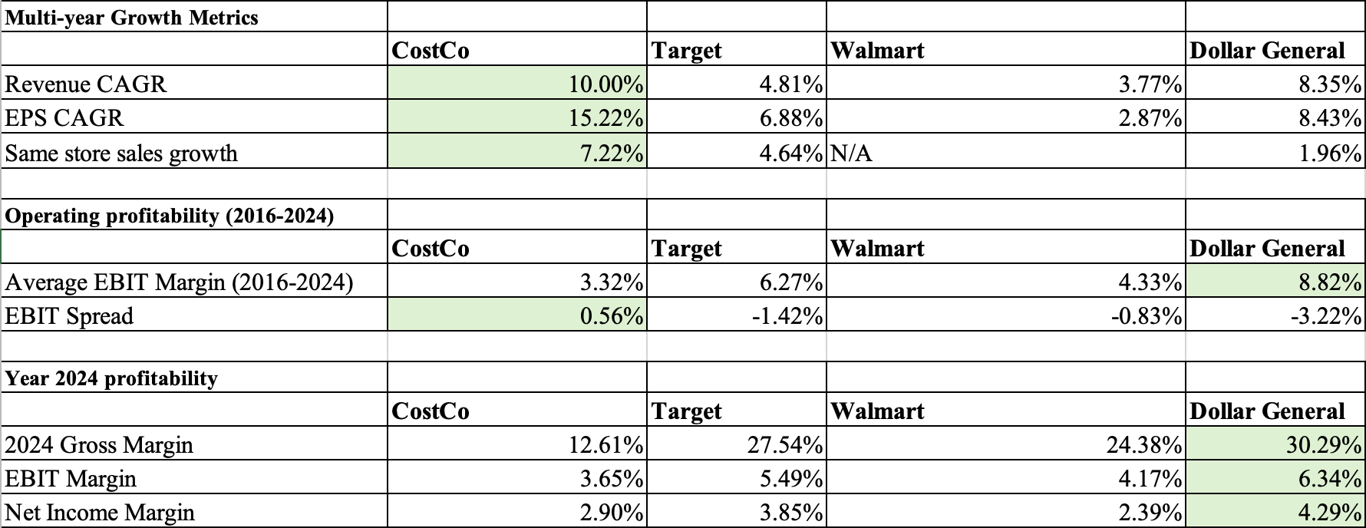

Slide 14
recommendations for Costco to achieve/continue the strong growth
Focus on internal growth rather than expansion
  Ex: Travel services, CostCo brand Kirkland, products for sale, and healthcare
Enhance membership value, not discounts
Keep membership fee increases gradual
Expand CostCo business centers
Lean harder into the membership model
  Expand premium/executive tiers

Slide 15
How Do You Beat Costco?
Offer Convenience
  Offer greater product differentiation.
  Offer a reliable e-commerce service.
  Offer convenient services like curbside pick-up.

